Slide 1


Introduction to Cloud Computing with R in Google Cloud and Amazon Web Services Session 3: Running R in Google Cloud Platform
Sounak Chakraborty
Associate Professor, Department of Statistics
http://faculty.missouri.edu/chakrabortys/

Slide 2
What we will learn in this session ?
We will Learn how to run R code in Google cloud platform. You can also run other softwares like Python in Google Cloud (but that will be another short course).
You need to have a Gmail/Google account for this.
Google cloud gives you at the beginning $300 worth of computing time for free to be used in the first 90 days. After that you need to pay. The free policies often change.
Detail pricing information can be found in https://cloud.google.com/compute/pricing
You should have already set up your google compute account to proceed further in this session following the guidelines in softwarerequirements slide.

Slide 3
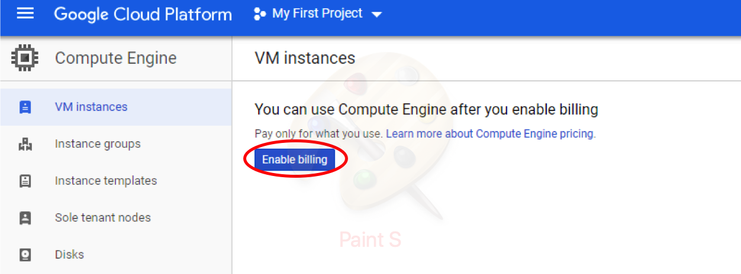
Lets begin
Login to your Gmail/Google account
Go to https://cloud.google.com/compute/
Depending on how your payment setup sometime you may not see this enable billing message.

Slide 4
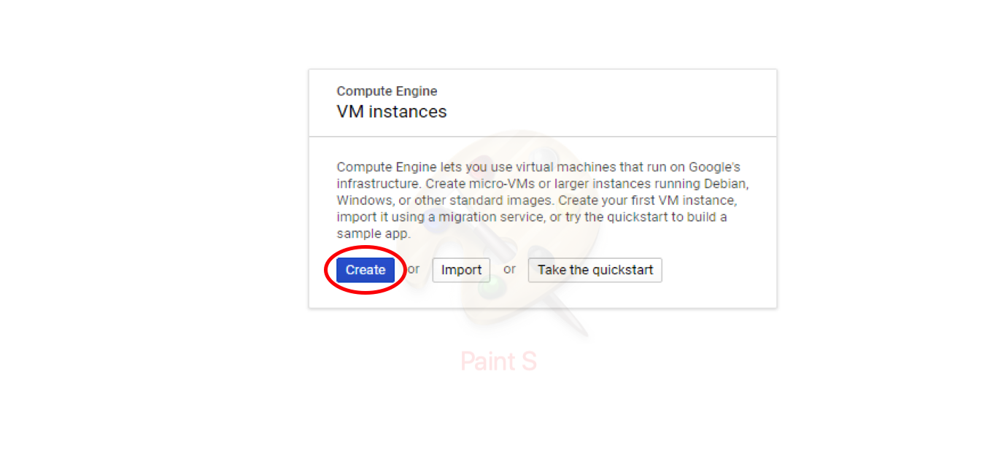
Chose a computer/virtual machine (vm)
Click on Create to create a virtual machine in Google cloud, where you will run your jobs. You can create multiple virtual machine. Each can be designed depending on the type of jobs you prefer to run.

Slide 5
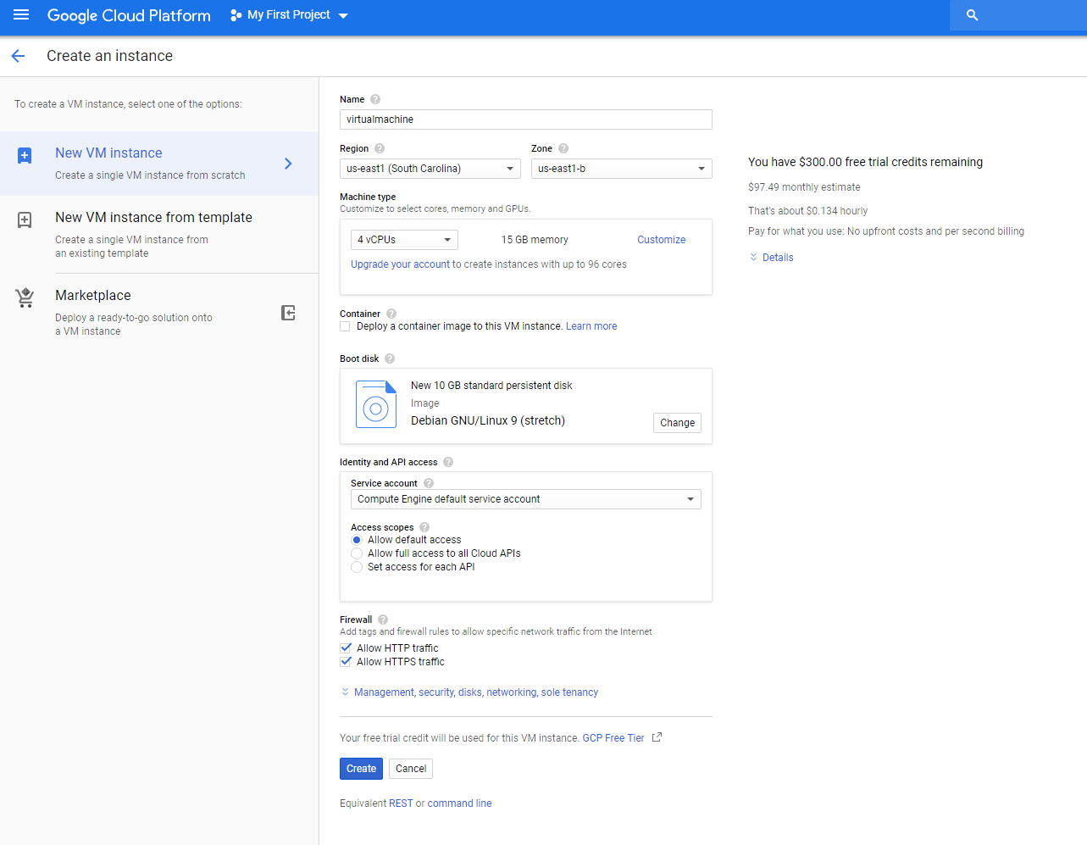
Chose a computer/virtual machine (vm)
Create a Name: “virtualmachine”. You can pick your own name, number of vCPUs, RAM, Operating System. Here we have chosen 4 core CPU, 16 GB RAM, Debian GNU/Linux 10 (buster) OS, HTTP/HTTPS access checked.
I suggest you chose 4 core CPU, 16 GB RAM, Debian GNU/Linux 10 (buster).
Do not click Create yet.

Slide 6
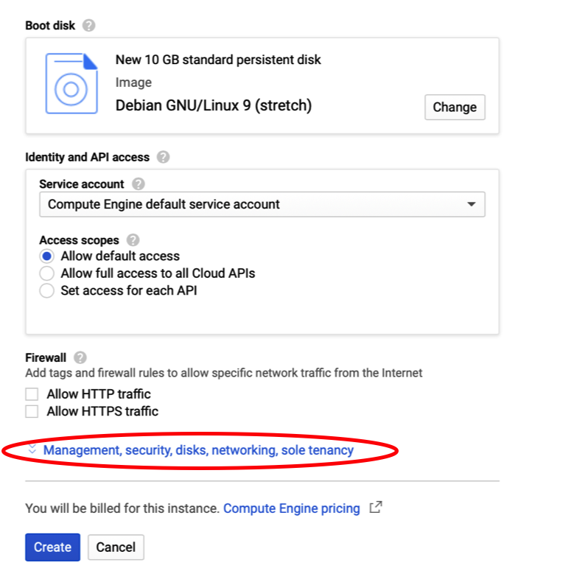
Preemptive option
A pre-emptible Virtual Machine is an instance that you can create and run at a much lower price than normal instances. However, Compute Engine might terminate (preempt) these instances if it requires access to those resources for other tasks. In Slide 7.
These VMs shuts down automatically when there is no processing running.
Click on “Management, security, disks, networking, sole tenancy” link while creating the virtual machine.

Slide 7
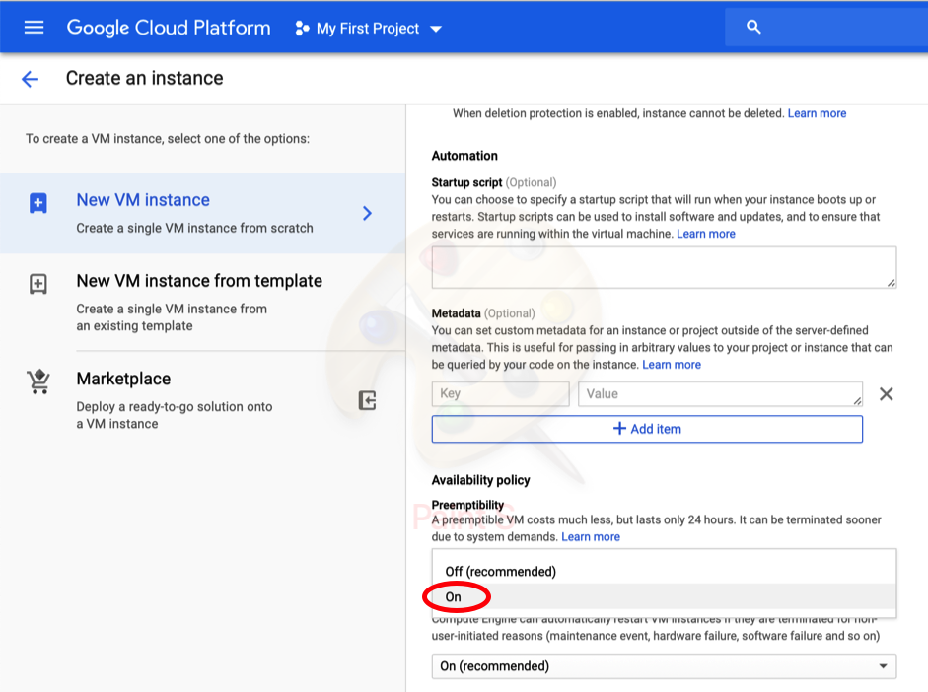
Preemptive option
Select “On” as shown in the picture to enable preemptibility of the VM.
Click Create.

Slide 8
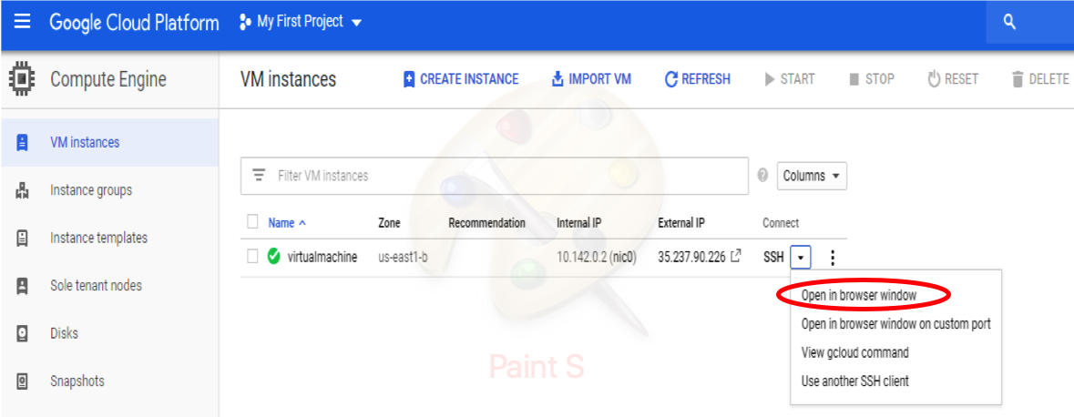
Your virtual machine
You have now created a virtual machine.
Now you will install necessary packages/softwares in your vm.
Click on Open in browser window under SSH tab.
Click on Open in browser window.

Slide 9
Compute Engine infrastructure
You create your virtual machine based on your project need
General purpose (E2, N1, N2, N2D) machines provide a good balance of price and performance
Compute optimized (C2) machines offer high-end vCPU performance for compute-intensive workloads
Memory optimized (M2) machines offer the highest memory and are great for in-memory databases
Accelerator optimized (A2) machines are based on the A100 GPU, for very demanding applications
The cost goes up when you create more powerful machine architecture
GPUs can be added to accelerate computationally intensive workloads like machine learning, simulation, and virtual workstation applications. Add or remove GPUs to a VM when your workload changes and pay for GPU resources only while you are using them.
Google bills in second-level increments. You pay only for the compute time that you use.

Slide 10
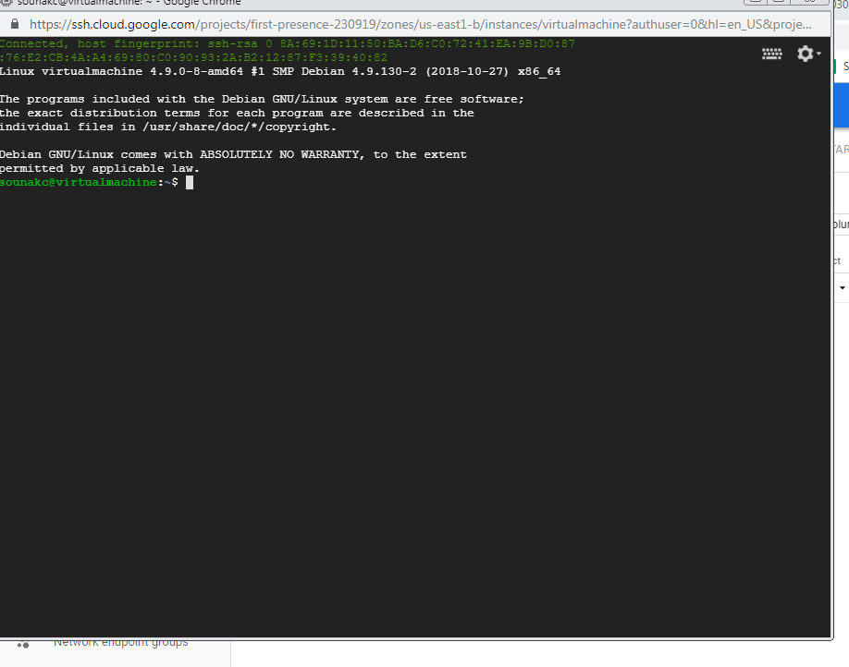
Installing r in your vm
We need to install R in every virtual machine we use.
To install R base package in Google cloud type sudo apt-get install r-base and enter and follow the screen instruction. It will install R 3.5.2
Click on top right gear button and select upload file to upload your R script (example: testR.R)

Slide 11
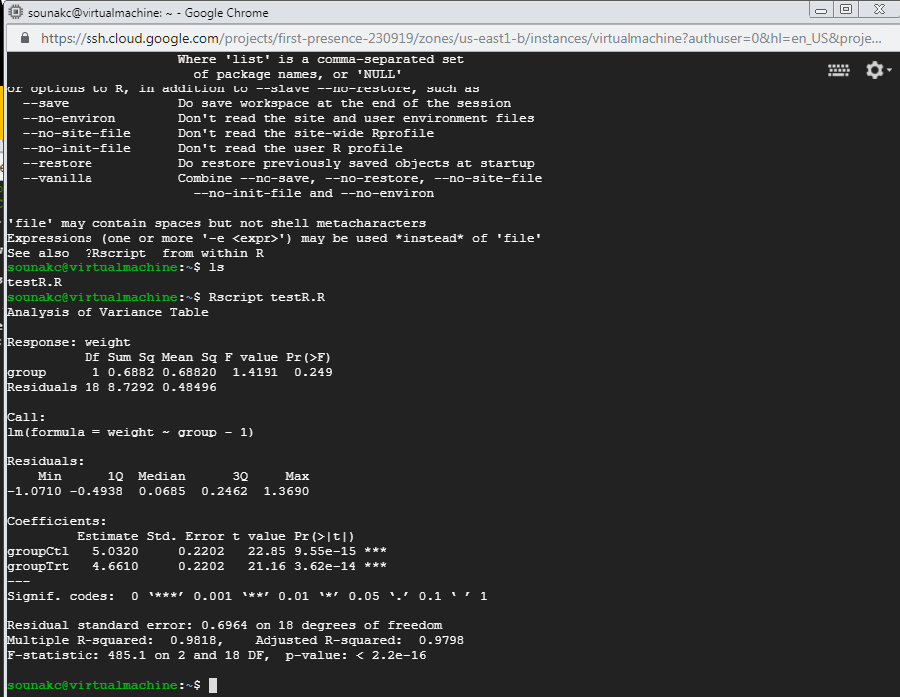
Run your R script in Google cloud vm
Type ls to check your code file correctly uploaded.
To run your R script type Rscript testR.R and you will see the code executed with the output as in the picture.

Slide 12
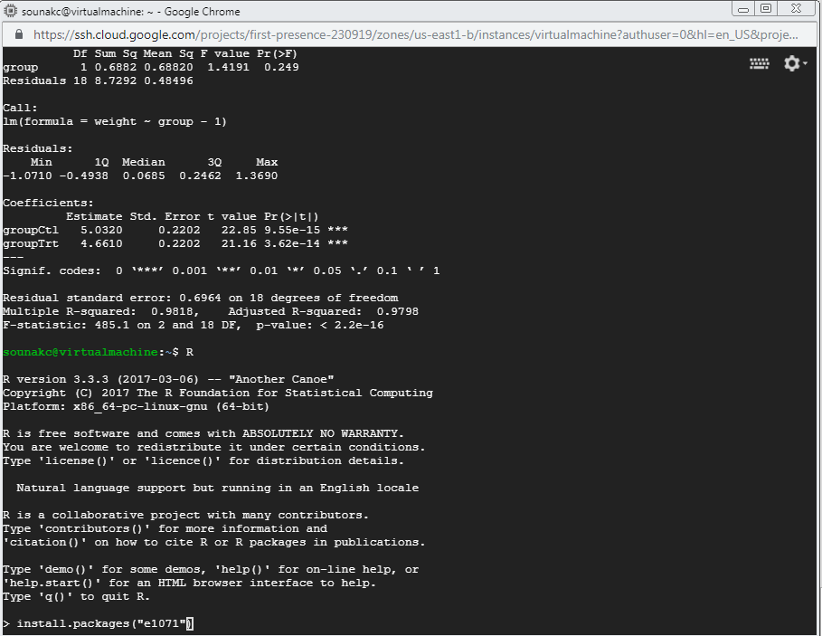
Installing R packages
Type R to go to R console
To install a package (example: “e1071”) you need to type install.packages(“e1071”) in the interactive R console.
Use personal library option
Install all libraries in your VM by issuing the bellow command in R console:
install.packages(c("gdata", "foreign", "SASxport", "sas7bdat", "mvtnorm", "rpart", "pwr", "nnet"))
It will take around 3-5 mins
libraries “foreign” and “SASxport” may not install as they are not available for R 3.5.2

Slide 13
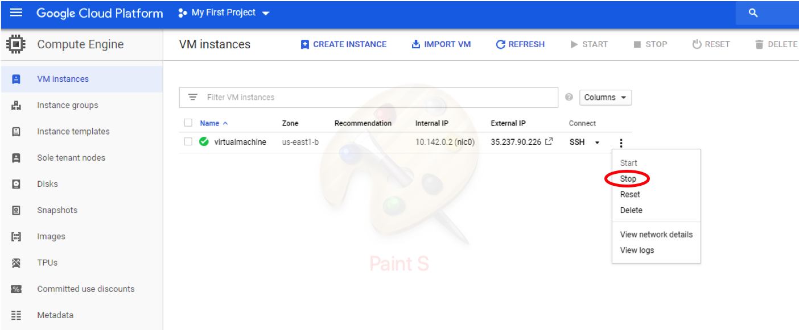
Stopping the vm
After you done working with the virtual machine, stop it by clicking on the 3 dotted button in the right, and select stop as shown in the picture.
It is very important that you stop the compute engine otherwise it will keep on running and you will be charged.

Slide 14
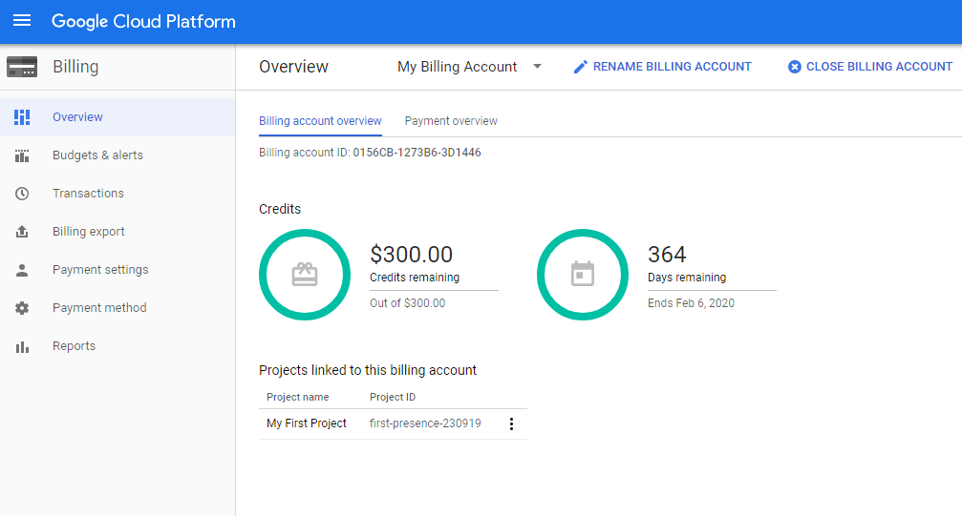
Billing Details
Billing Details
Currently google offers $300 credit 90 days only

Slide 15
Lets Create another vm and install a higher version of r
Click on create instance and create another virtual machine
Create 4 vCPU, 16gb ram, Debian GNU/Linux 10 (buster) os
To install a more recent version of R (R 3.6.3) copy paste the commands below after you start your new vm
sudo apt install dirmngr --install-recommends
sudo apt install software-properties-common
sudo apt install apt-transport-https
sudo apt-key adv --keyserver keys.gnupg.net --recv-key 'E19F5F87128899B192B1A2C2AD5F960A256A04AF'
sudo apt update
sudo apt install r-base

Slide 16
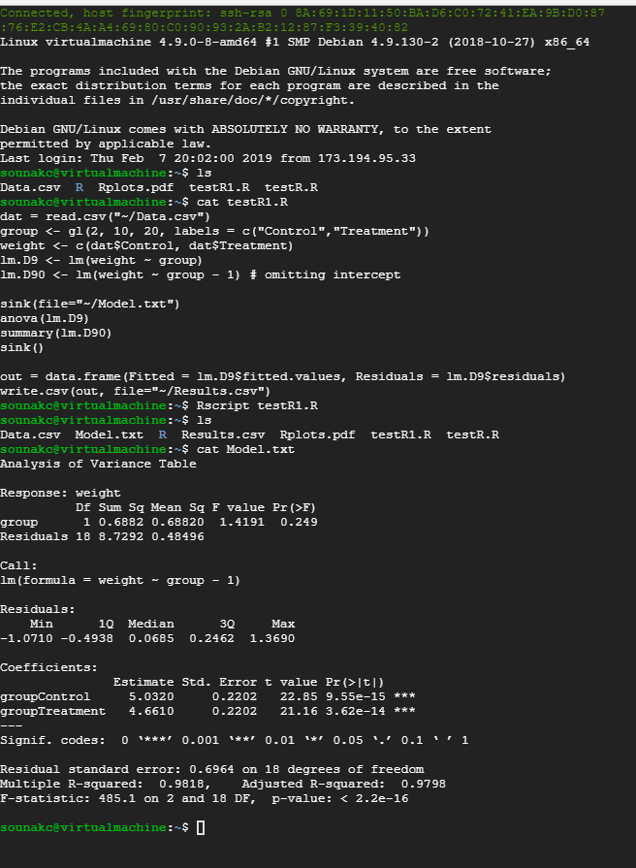
Example running r which access a dataset file
Click on top right gear button and select upload file to upload your R script (testR1.R) and data file (Data.csv).
Type ls to check successful upload.
Type cat testR1.R to view the R script.

Slide 17
Example running r which access a dataset file
The testR1.R will read data from data file Data.csv, fit a linear regression and anova model, write model output/summary in a file Model.txt, and writing the fitted values and residuals in Results.csv file.
To run type Rscript testR1.R
Type ls to see Model.txt and Results.csv file created.
Type cat Model.txt to view the model summary.

Slide 18
Downloading files from cloud
Click on top right gear button and select download file to download your model outputs (Model.txt, Results.csv, RPlots_example2.pdf) on your local machines.
To download in the download box provide the name of the file you want to download.
To delete any file from the cloud type rm filename (testR1.R).

Slide 19
Try to Create a third mega Virtual Machine
Click on create instance and follow the instruction in slide 5-7
Select Machine Family: Compute Optimized
Machine type: series c2 30 CPU, 160 GB RAM
OS: Linux Ubuntu 18.04 LTS
You may see a failure in creating a VM. This happens if your chosen region and zone don’t have enough such machines to support your request. Remember all 30 CPU need to come from the same chosen region and zone to work well at tandem.
This may also because you are under free trial
Lets Select Machine Family: General Purrpose Series E2, 16CPU, 32GB RAM, Debian GNU/Linux 10 (buster) OS.
Install R (default R)

Slide 20
example: fitting lasso
The testR2.R will install package “elasticnet”, fit lasso model on dataset “Diabetes”, write output/summary in a file Model_example3.txt, and plots the solution paths in RPlots_example3.pdf.
To run type Rscript testR2.R
Type ls to see Model.txt and RPlots_example3.pdf created.
Type cat Model.txt to view the model summary.
Click on top right gear button and select download file to download your model outputs (Model_example3.txt, RPlots_example3.pdf) on your local machines.
To download in the download box provide the name of the file you want to download.
To delete any file from the cloud type rm filename (testR2.R).
Notes:
End of lecture 3

Slide 21
Some linux commands
To uninstall/remove your R: sudo apt remove r-base-core
To look into history of issued commands: history
To see the r version installed: R –version
To see the list of files in a directory: ls

Slide 22
Parallel computation using multiple cpu cores in google cloud
Why parallelism?
Much R code runs fast and fine on a single processor. But at times, computations can be:
cpu-bound: Take too much cpu time
memory-bound: Take too much memory
I/O-bound: Take too much time to read/write from disk
network-bound: Take too much time to transfer
To help with cpu-bound computations, one can take advantage of modern processor architectures that provide multiple cores on a single processor, and thereby enable multiple computations to take place at the same time.
In addition, some machines have multiple processors, allowing large computations to occur across the entire cluster of those computers. Plus, these machines also have large amounts of memory to avoid memory-bound computing jobs.

Slide 23
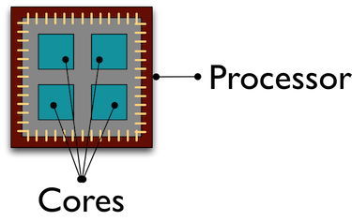
Processors (CPUs) and Cores
A modern CPU (Central Processing Unit) is at the heart of every computer. While traditional computers had a single CPU, modern computers can have multiple processors, which in turn can each contain multiple cores. These processors and cores are available to perform computations.
A computer with one processor may still have 4 cores (quad-core), allowing 4 computations to be executed at the same time.
In our case 8 vCPU = 8 cores

Slide 24
When to parallelize ?
in theory each added processor would linearly increase the throughput of a computation, but there is overhead that reduces that efficiency.
For example, the code and, importantly, the data need to be copied to each additional CPU, and this takes time and bandwidth.
Also, new processes and/or threads need to be created by the operating system, which also takes time.
So taking all that in account the computation could potentially take longer in parallel.
finally, not all task can be parallelized.
When you have a list of repetitive tasks, you may be able to speed it up by adding more computing power. If each task is completely independent of the others, then it is a prime candidate for executing those tasks in parallel, each on its own core.

Slide 25
How to parallelize easily
Use the multiple cores mclapply
Use multiple processors on machines using makeCluster and clusterApply
In this approach, one has to manually copy data and code to each cluster member using clusterExport
This is extra work, but sometimes gaining access to a large cluster is worth it
In this short course we will only illustrate using mcapply
Notes:
These are R functions

Slide 26
Parallelize using: mclapply
The parallel library can be used to send tasks (encoded as function calls) to each of the processing cores on your VM in parallel. T
his is done by using the mclapply function in the parallel library, distributes the tasks to multiple processors/cores.
mclapply gathers up the responses from each of these function calls, and returns a list of responses that is the same length as the list or vector of input data (one return per input item).

Slide 27
Parallelize using: mclapply: example
library(parallel)
library(MASS)
starts <- rep(100, 40) # 100 parallel jobs starting
fx <- function(nstart) kmeans(Boston, 4, nstart=nstart) # kmeans with each 100 starting values
numCores <- detectCores() # finding out number of cores available
numCores
system.time( results <- lapply(starts, fx) ) # one core
system.time( results <- mclapply(starts, fx, mc.cores = numCores) ) # multi core
Note: the elapsed time is the time charged to the vCPU(s) for the expression.

Slide 28
Parallelize using: mclapply: another example
Lets use sample with replacement to do a bootstrap analysis. In this case, we select Sepal.Length and Species from the iris dataset, subset it to 100 observations, and then iterate across 10,000 trials, each time resampling the observations with replacement. We then run a logistic regression fitting species as a function of Sepal.length, and record the coefficients for each trial to be returned.

Slide 29
Parallelize using: mclapply: another example
x <- iris[which(iris[,5] != "setosa"), c(1,5)]
trials <- seq(1, 10000)
boot_fx <- function(trial) {
ind <- sample(100, 100, replace=TRUE)
result1 <- glm(x[ind,2]~x[ind,1], family=binomial(logit))
r <- coefficients(result1)
res <- rbind(data.frame(), r)
}
system.time({ results <- lapply(trials, boot_fx) }) # single core
system.time({ results <- mclapply(trials, boot_fx, mc.cores = numCores) }) # multi-core

Slide 30
Parallelize using: mclapply: another example
> system.time({ results <- lapply(trials, boot_fx) }) # single core
user system elapsed
20.993 0.000 20.994
> system.time({ results <- mclapply(trials, boot_fx, mc.cores = numCores) }) # multi-core
user system elapsed
28.252 0.220 4.110
Parallelization is 5 times faster

Slide 31
Parallelize for loop
The normal for loop in R looks like:
for (i in 1:3) { print(sqrt(i)) }
## [1] 1
## [1] 1.414214
## [1] 1.732051
The foreach method is similar, but uses the sequential %do% operator to indicate an expression to run. Note the difference in the returned data structure.
library(foreach)
foreach (i=1:3) %do% { sqrt(i) }
## [[1]]
## [1] 1
##
## [[2]]
## [1] 1.414214
## #
# [[3]]
## [1] 1.732051
In addition, foreach supports a parallelizable operator %dopar% from the doParallel package. This allows each iteration through the loop to use different cores or different machines in a cluster.

Slide 32
Parallelize for loop
library(foreach)
library(doParallel)
iteratorsregisterDoParallel(numCores) # use multicore, set to the number of our cores foreach (i=1:3) %dopar% { sqrt(i) }
## [[1]]
## [1] 1
##
## [[2]]
## [1] 1.414214
##
## [[3]]
## [1] 1.732051
To simplify output, foreach has the .combine parameter that can simplify return values.
foreach (i=1:3, .combine=c) %dopar% { sqrt(i) } #Return a vector
## [1] 1.000000 1.414214 1.732051
foreach (i=1:3, .combine=rbind) %dopar% { sqrt(i) } #Return a data frame
## [,1]
## result.1 1.000000
## result.2 1.414214
## result.3 1.732051

Slide 33
Benefits of Parallelizing the for loop
Let's use the iris data set to do a parallel bootstrap using the doParallel
x <- iris[which(iris[,5] != "setosa"), c(1,5)]
trials <- 10000
system.time({
r <- foreach(icount(trials), .combine=rbind) %dopar% {
ind <- sample(100, 100, replace=TRUE)
result1 <- glm(x[ind,2]~x[ind,1], family=binomial(logit))
coefficients(result1)
}
})
>user system elapsed
27.700 0.371 4.778

Slide 34
Benefits of Parallelizing the for loop
same analysis in serial for loop
system.time({
r <- foreach(icount(trials), .combine=rbind) %do% {
ind <- sample(100, 100, replace=TRUE)
result1 <- glm(x[ind,2]~x[ind,1], family=binomial(logit))
coefficients(result1)
}
})
user system elapsed
19.853 0.000 19.855

Slide 35
about parallel computing
In this short lesson we learnt how to use multicore vm for mclapply and for and take advantage of parallel computing in r.
Other packages are available for R that make it easy to program a cluster of nodes for your modeling and analytics: Snow, Rslurm, Rmpi etc.
In future we can arrange a short course dedicated only towards parallel computing in cloud and parallelizing your R codes with more expanded details.

Slide 36
Running Rstudio in google compute engine
The command line interface for r is less expensive
How ever the interface is not very appealing
Also data transfer, visualizations, code development, and execution is much less appealing if you don’t have much experience in linux environment, and some basic shell programming
in this lesson we will set up a rstudio interface in the google cloud, which will behave like your desktop rstudio.
It can easily access data files, R code files in your local folders but run all computations in the google compute engine.
The solution we provide for such is bit pricey. It cost approximately $1.50/hr.
But it is the most convenient and easy way to learn and set up without involving any complex shell programming.

Slide 37
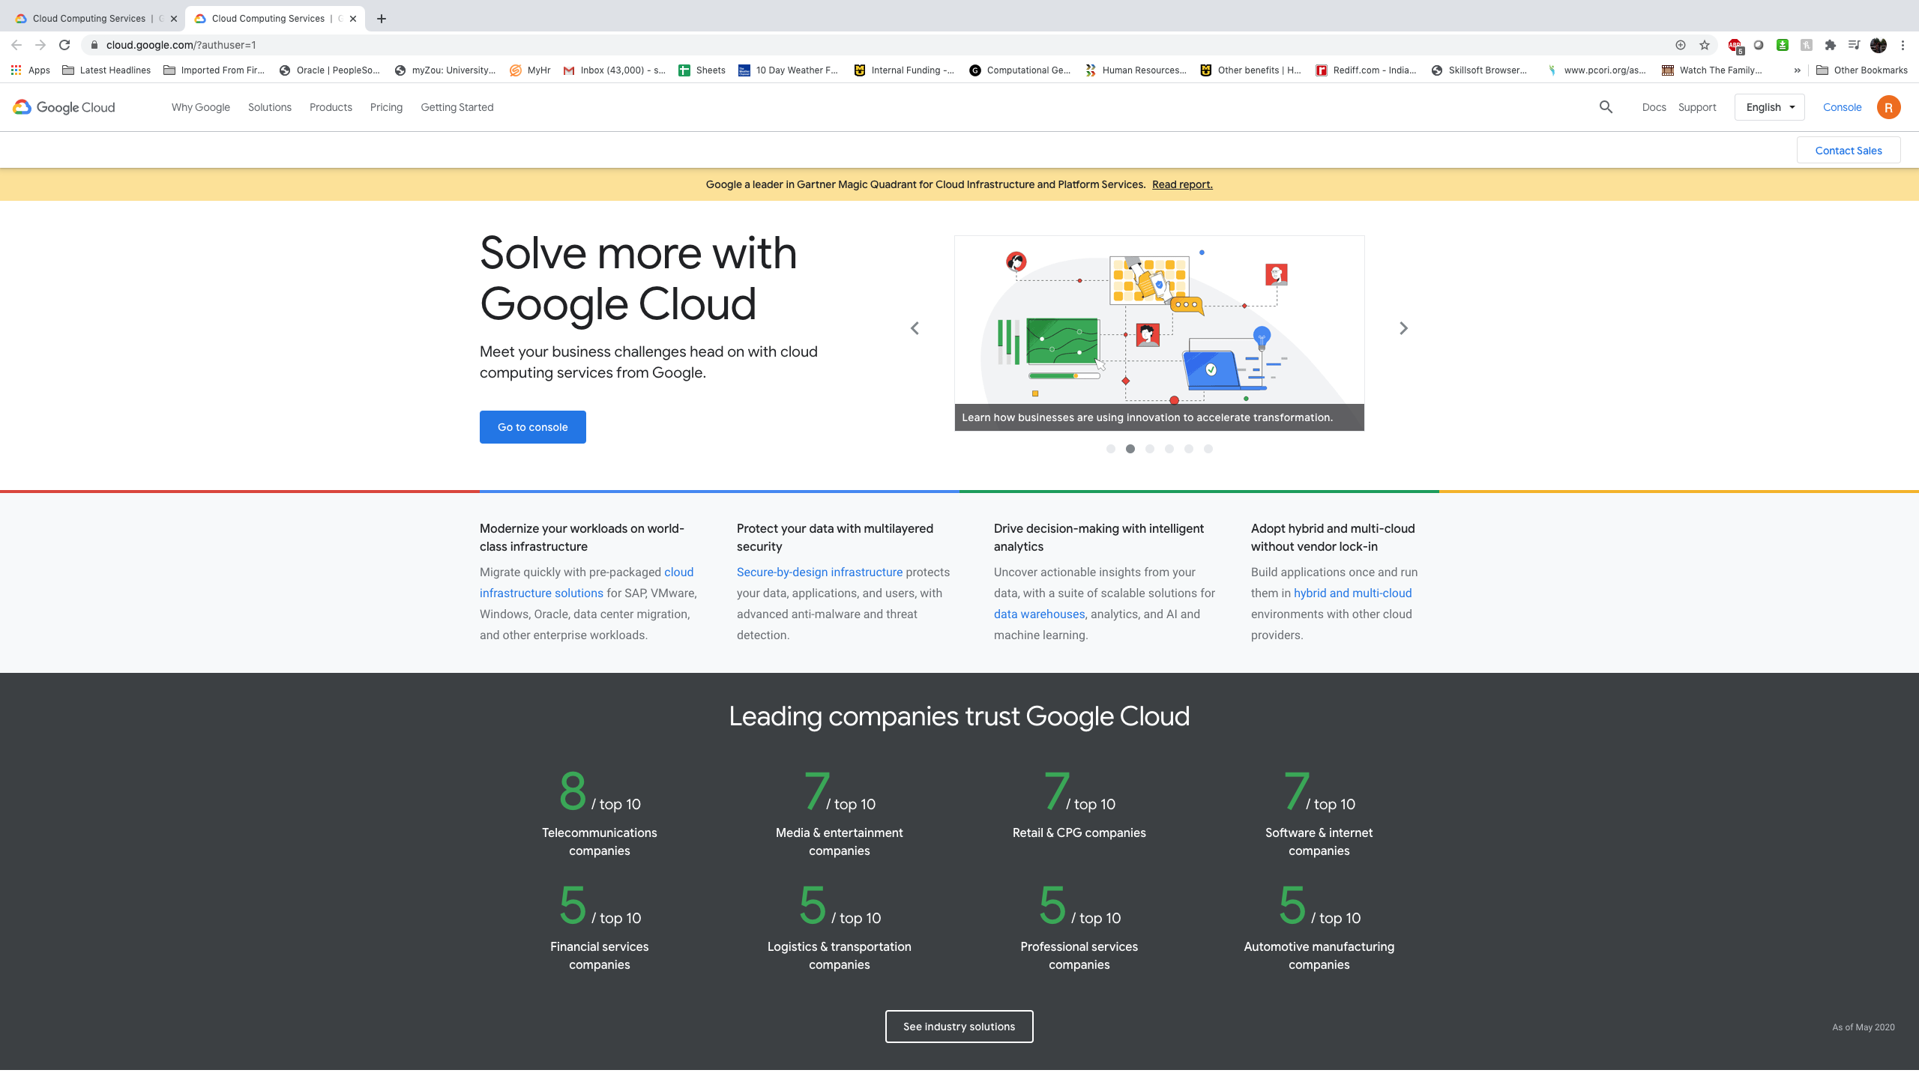
Setting up rstudio in google cloud
Step 1: goto cloud.google.com and click console

Slide 38
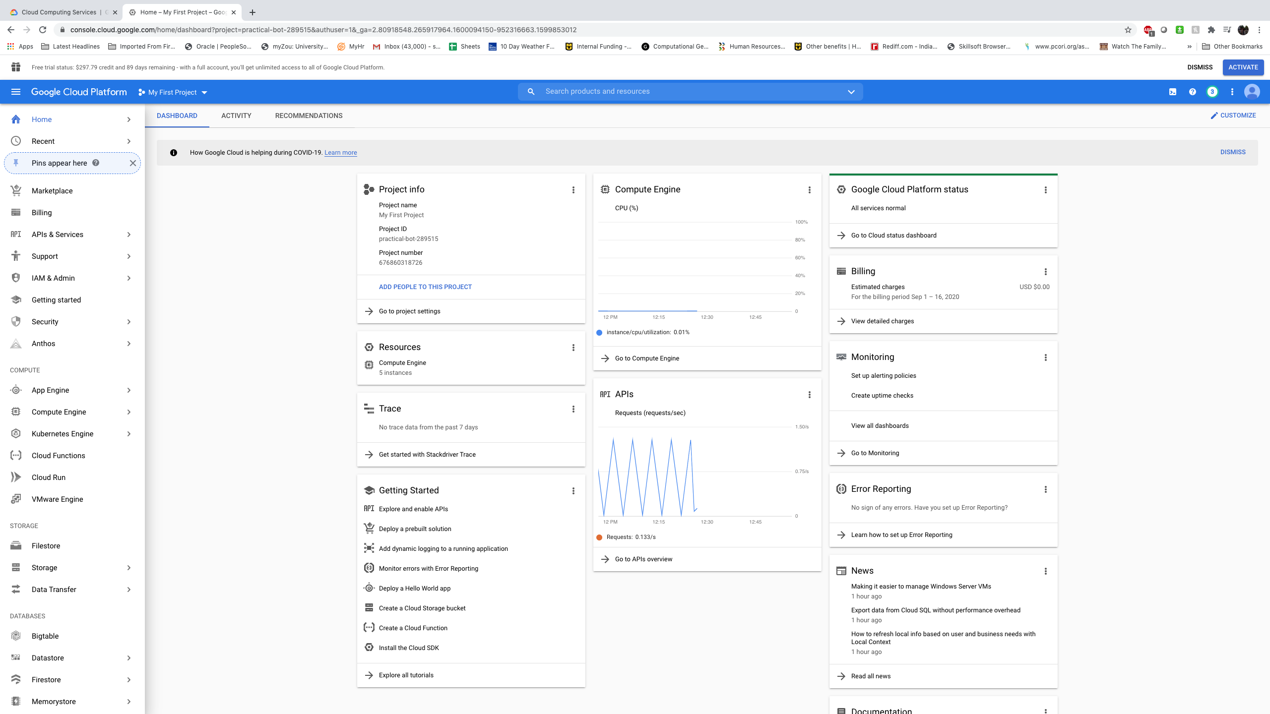
Setting up rstudio in google cloud
Step 2: Click on cloud Run

Slide 39
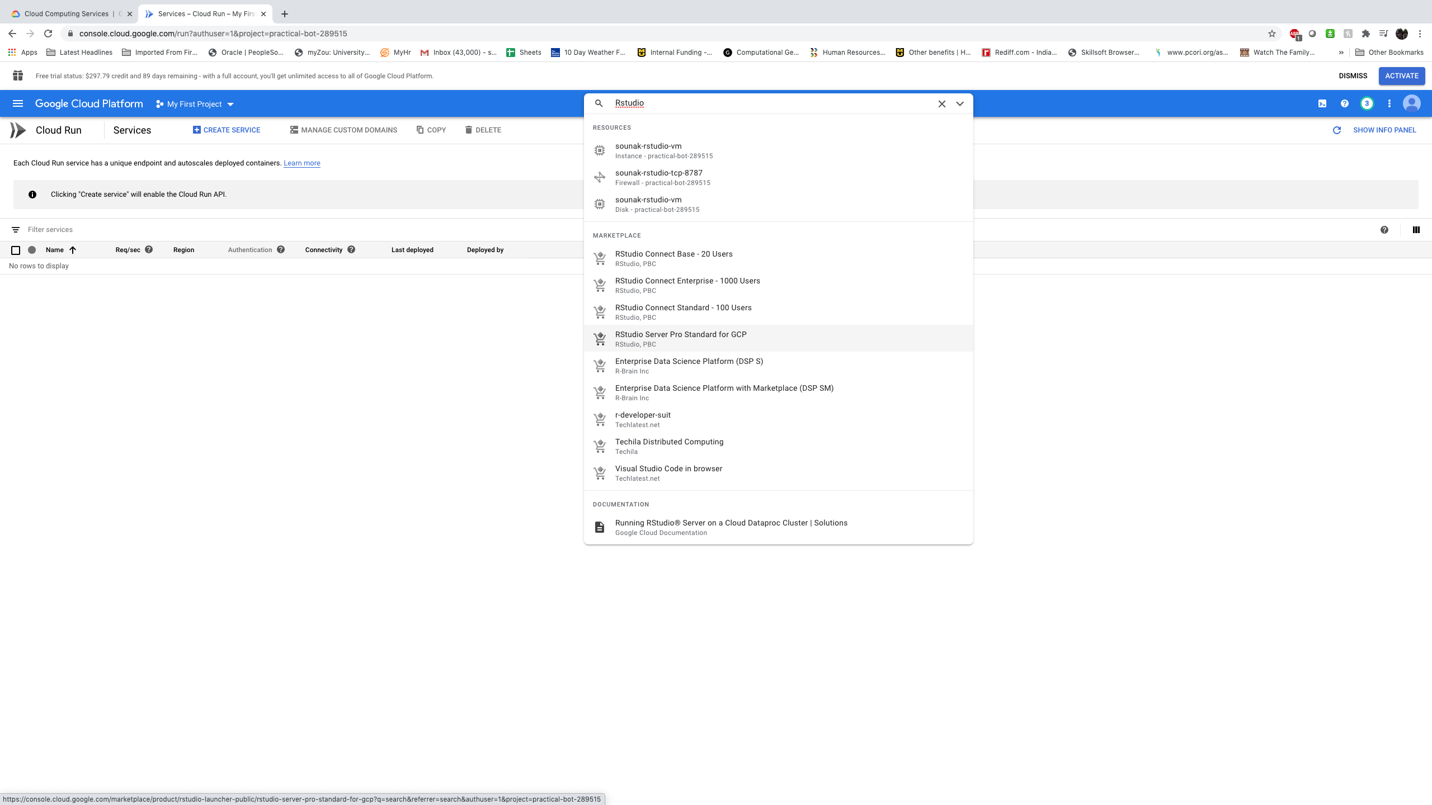
Setting up rstudio in google cloud
Step 3: Search RStudio and select RStudio Server Pro Standard for gcp

Slide 40
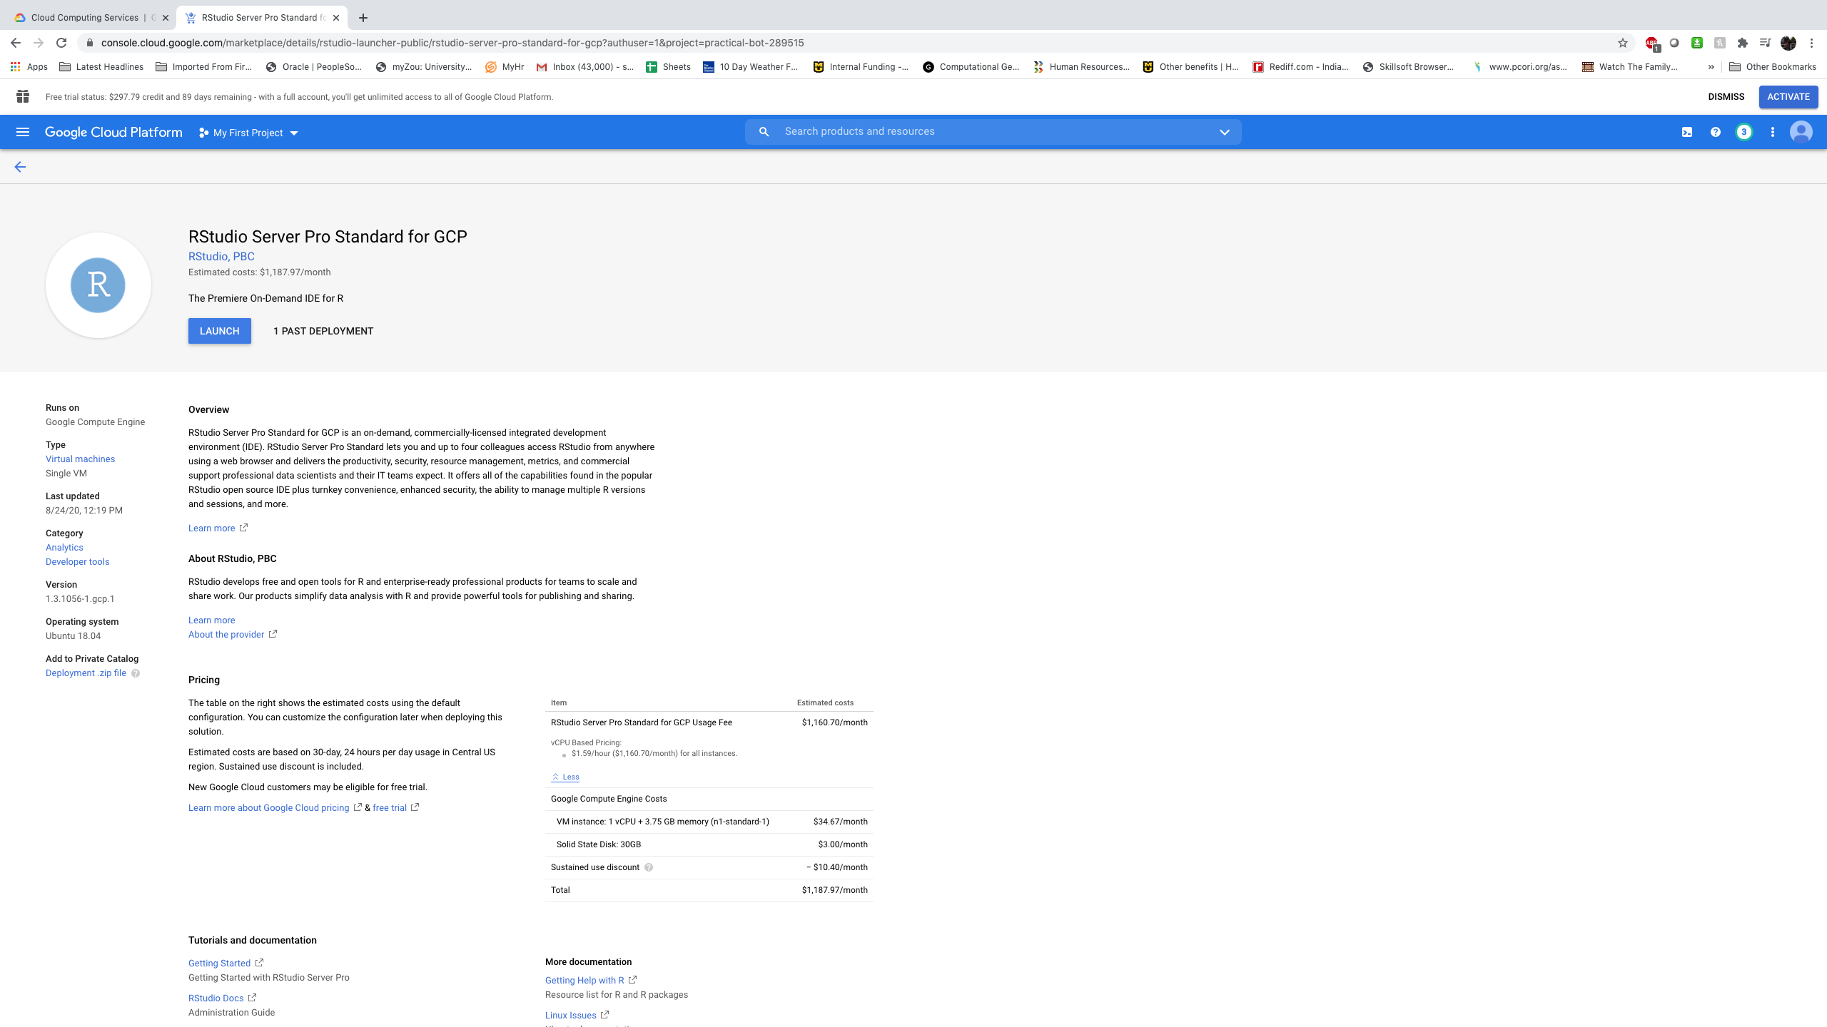
Setting up rstudio in google cloud
Step 4: click launch

Slide 41
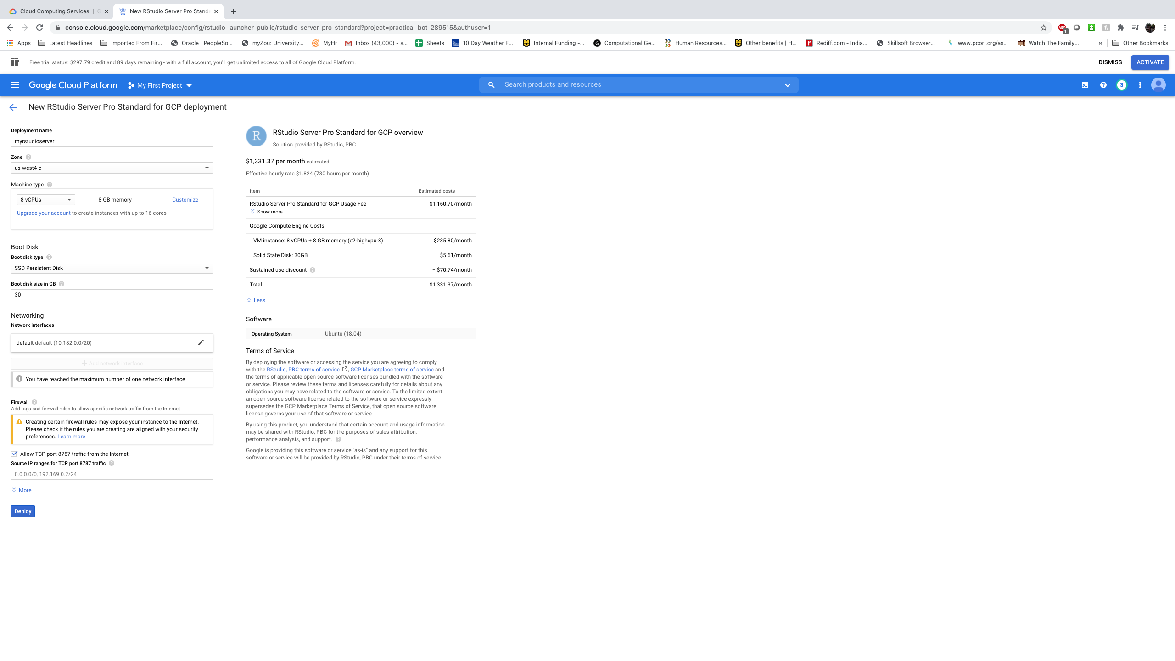
Setting up rstudio in google cloud
Step 5: select machine type

Slide 42
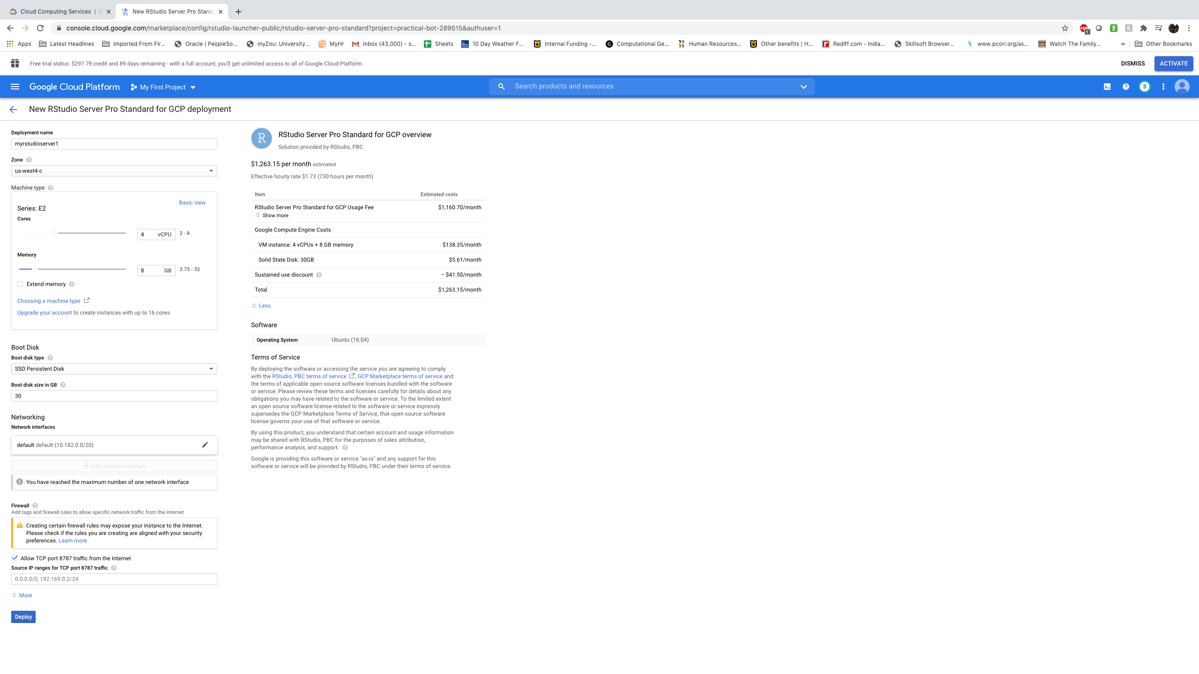
Setting up rstudio in google cloud
Step 5: select machine type customized way

Slide 43
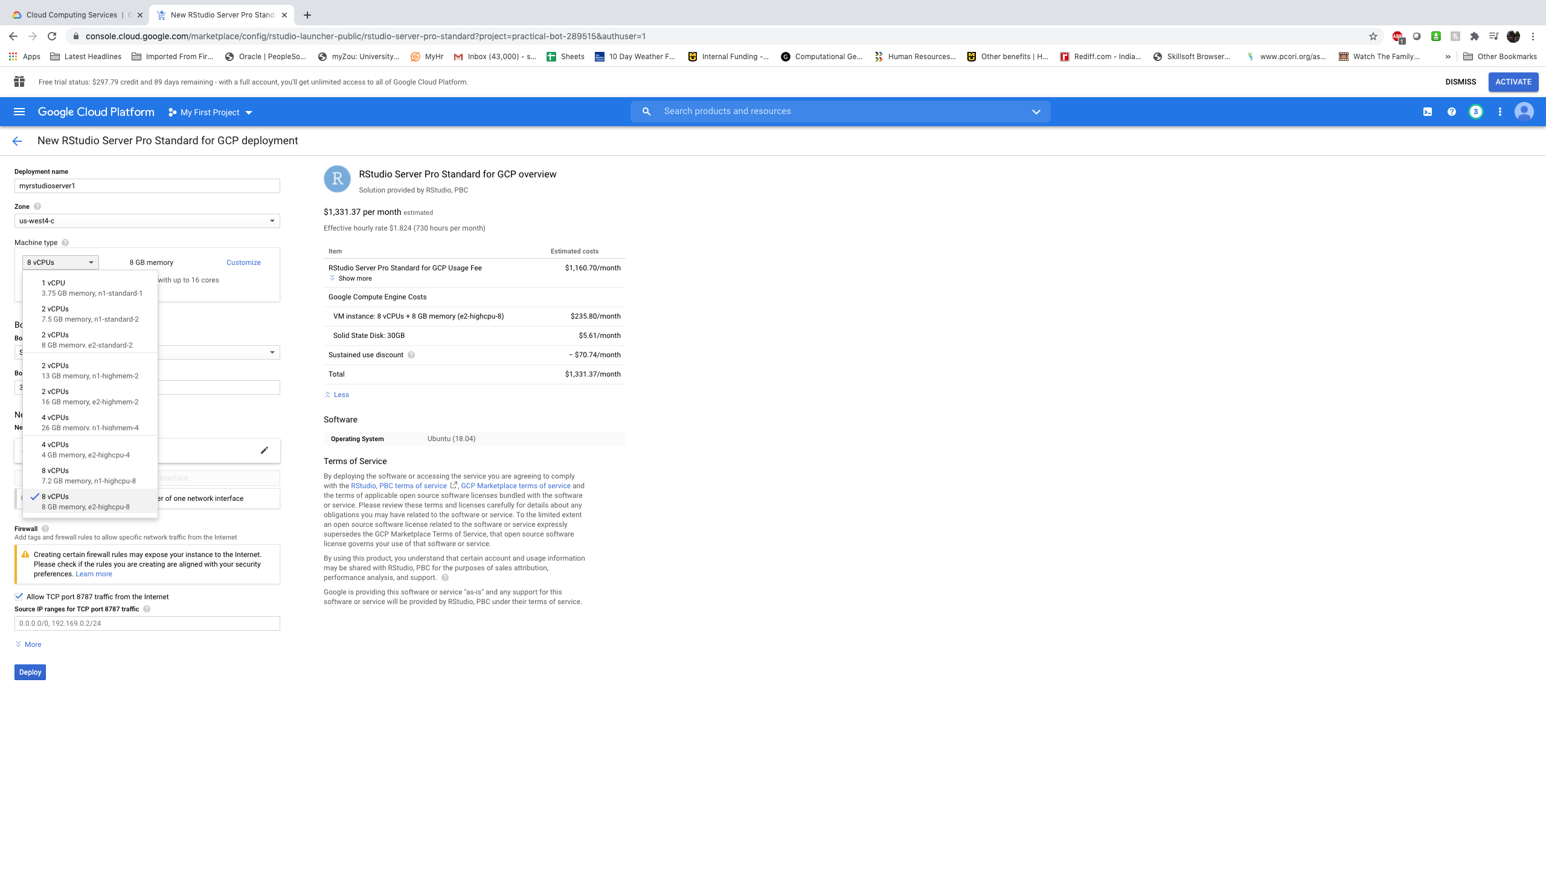
Setting up rstudio in google cloud
Step 5: select machine type

Slide 44
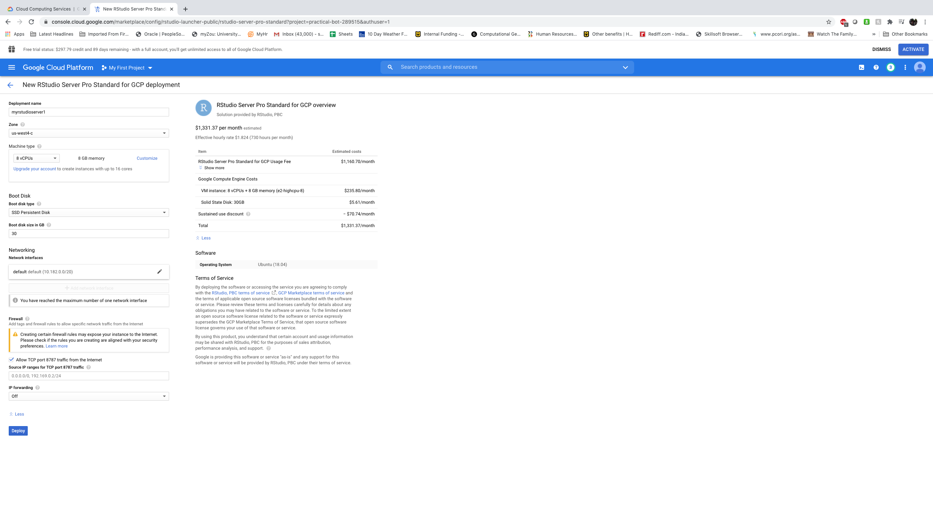
Setting up rstudio in google cloud
Step 5: select machine type 8 vCPU and 8 GB RAM, 30 GB hard drive. Click deploy.

Slide 45
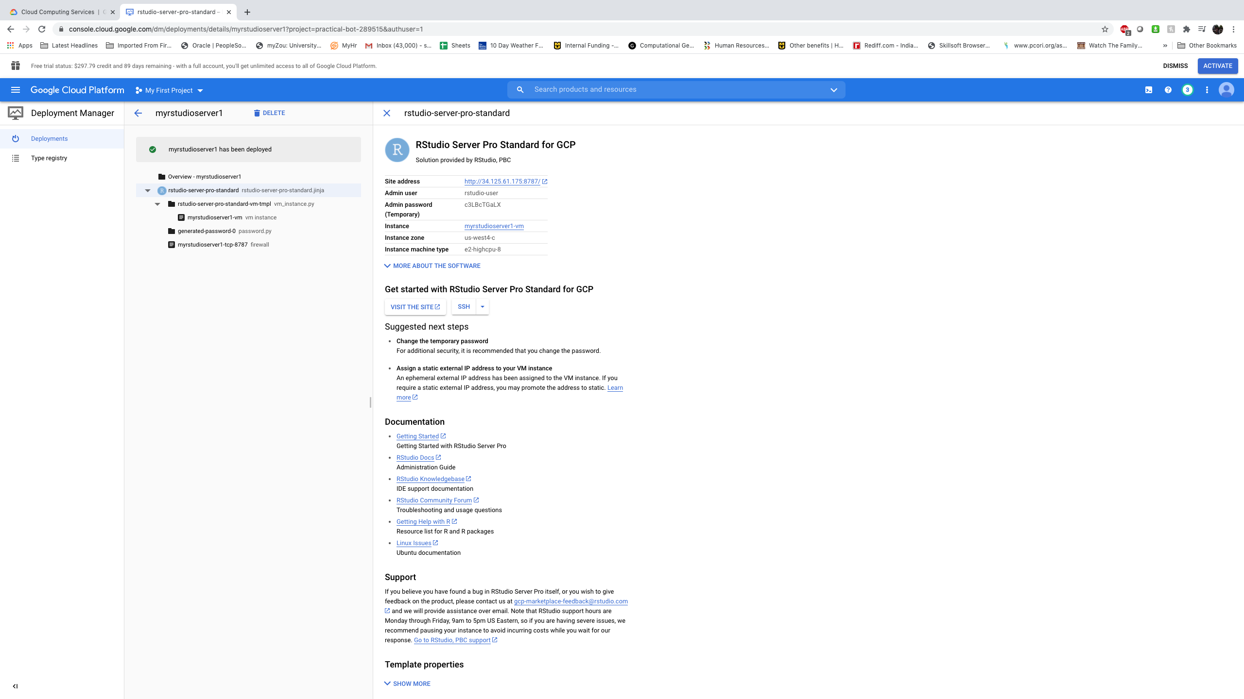
Setting up rstudio in google cloud
Step 6: Rstudio server now created. Click on the side address. Note Admin user and Admin password.

Slide 46

Setting up rstudio in google cloud
Step 7: Click on HTTP link if this page comes.

Slide 47

Setting up rstudio in google cloud
Step 8: Give the Admin username and Admin Password

Slide 48
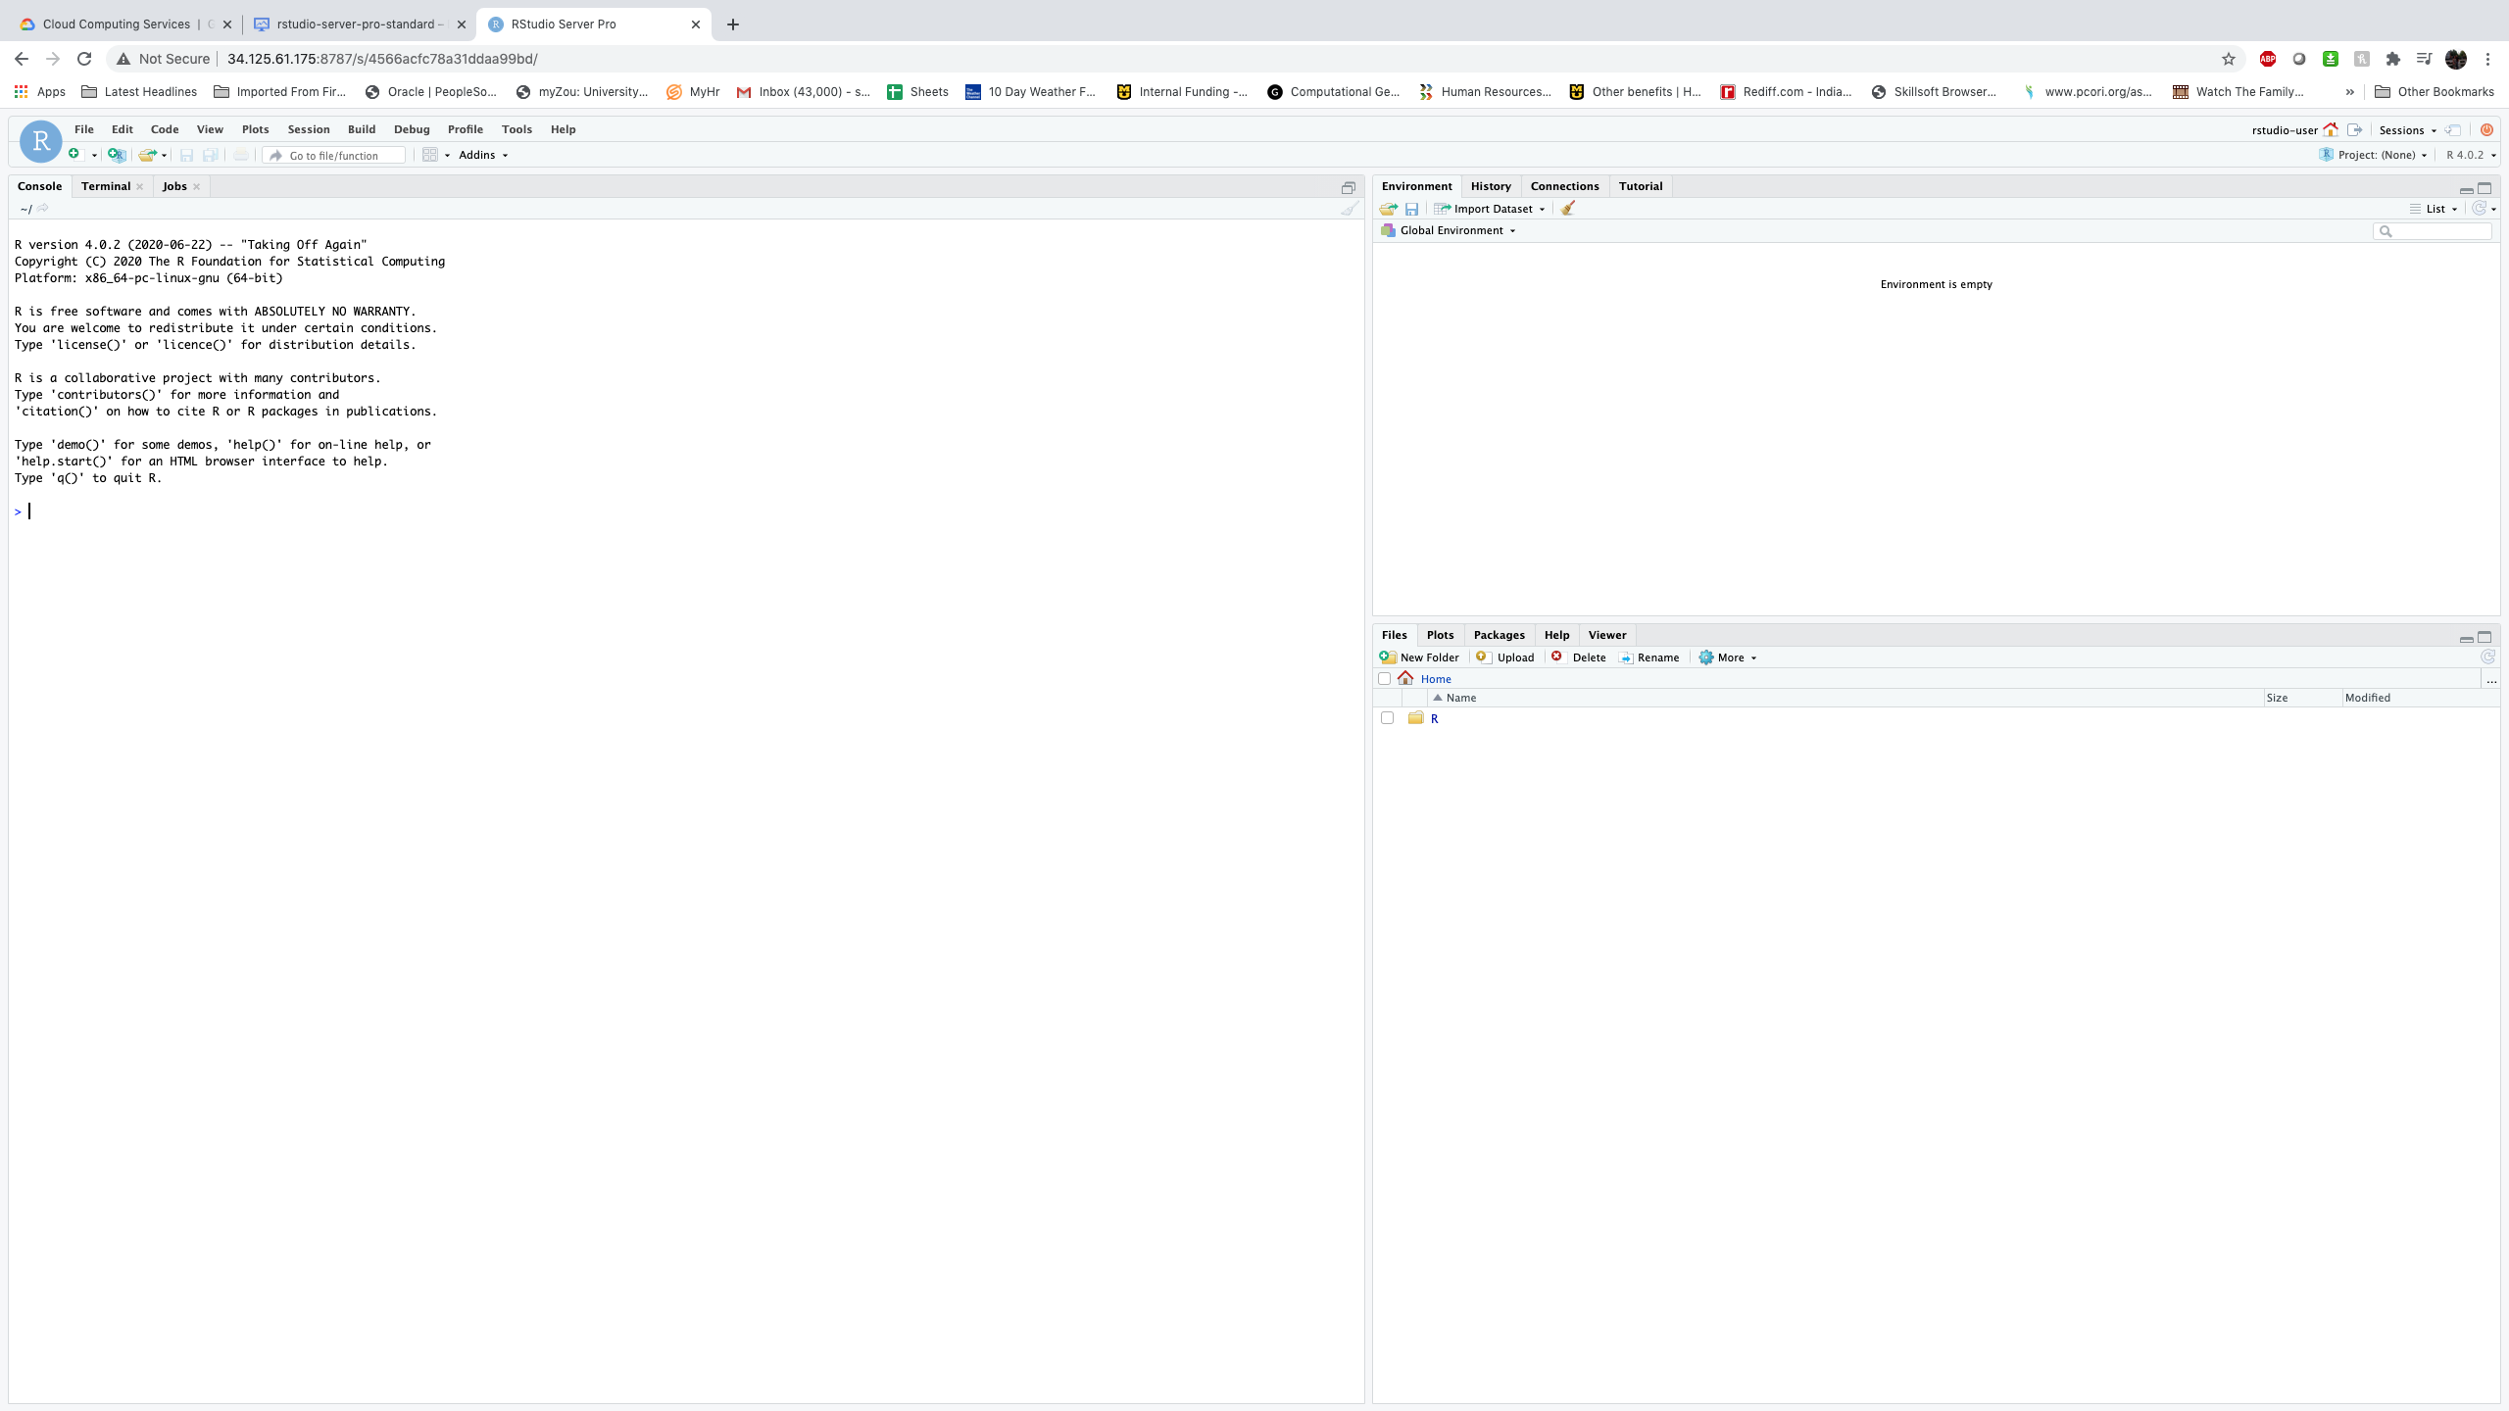
Setting up rstudio in google cloud
Step 9: Congratulation !!! you have now RStudio up and running in your Google Cloud.
Use it just in the same way you use RStudio desktop.

Slide 49
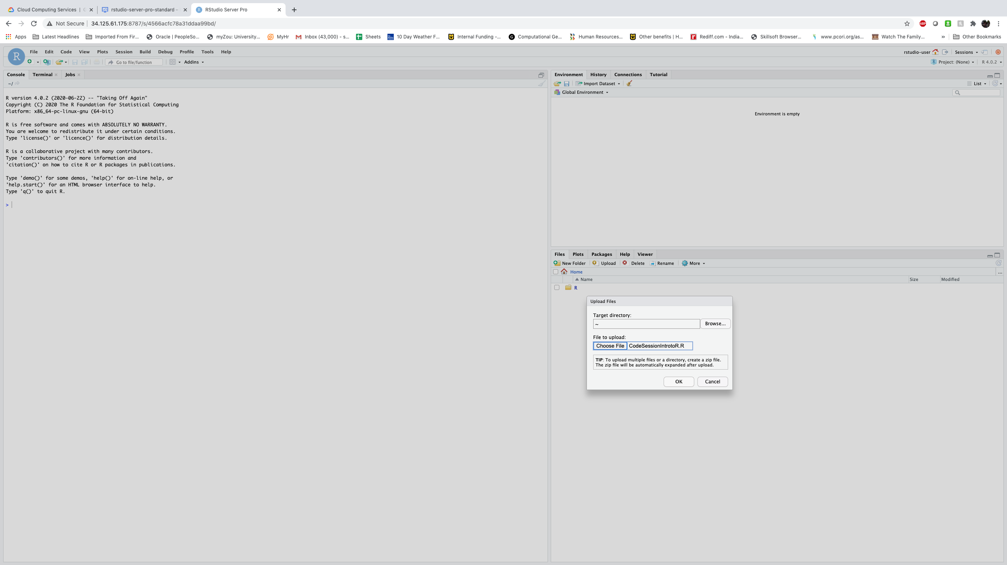
Running code in rstudio in google cloud
To upload file click on upload. Select the file CodeSessionIntroR.R and the data file CARS93.DAT one at a time.

Slide 50
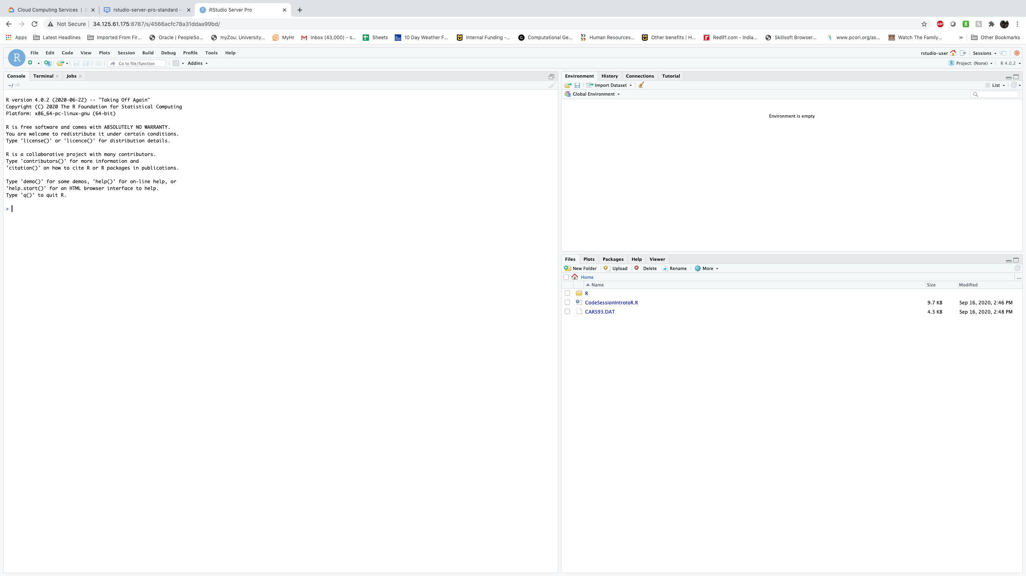
Running code in rstudio in google cloud
To upload file click on upload.

Slide 51
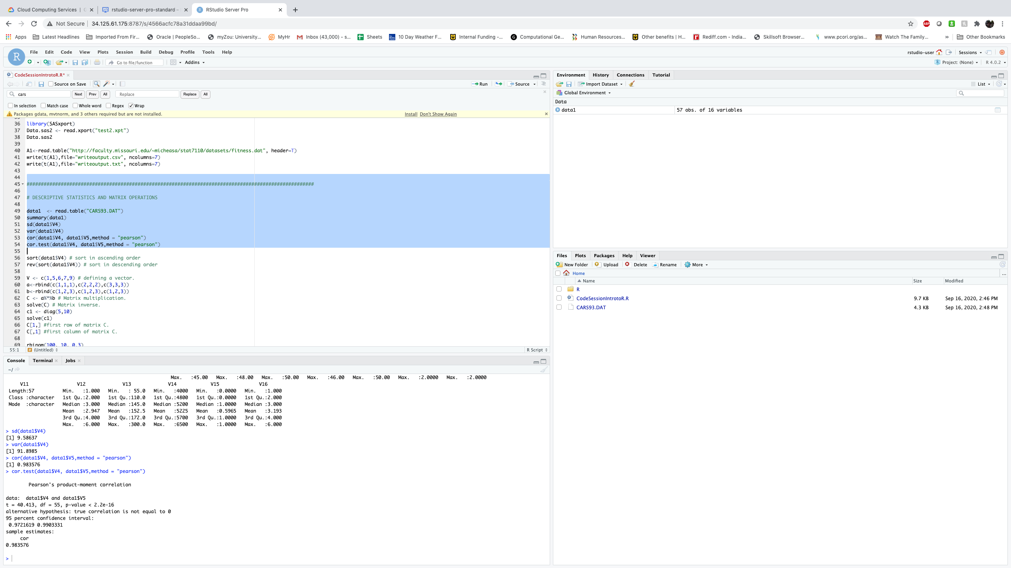
Running rstudio in google cloud
A RStudio running session in google cloud

Slide 52
Changing password of rstudio server in google cloud
Once logged in, set a new password for this user
Click on the Terminal pane in the bottom left-hand corner
At the prompt type passwd
Enter the current password and the new password twice, hitting the enter key after each entry

Slide 53
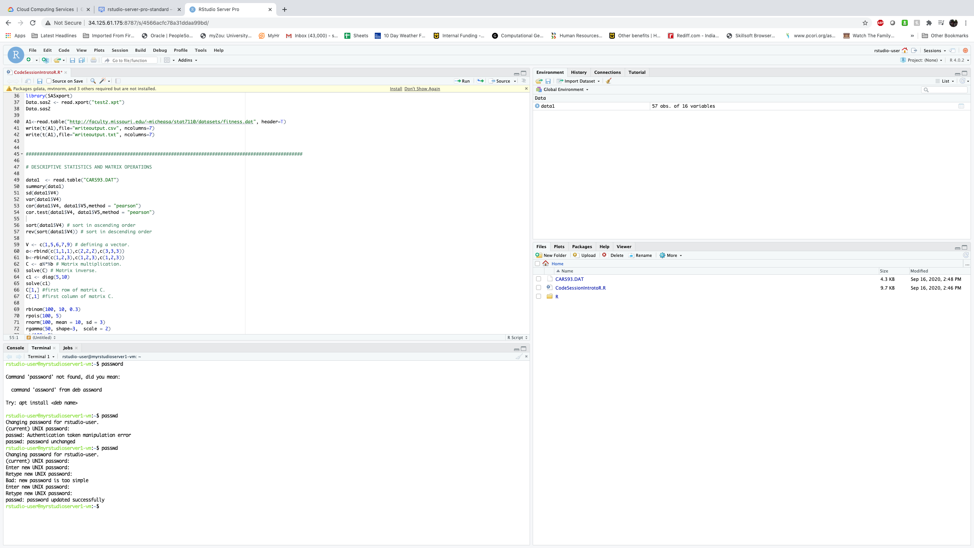
Changing password of rstudio server in google cloud

Slide 54
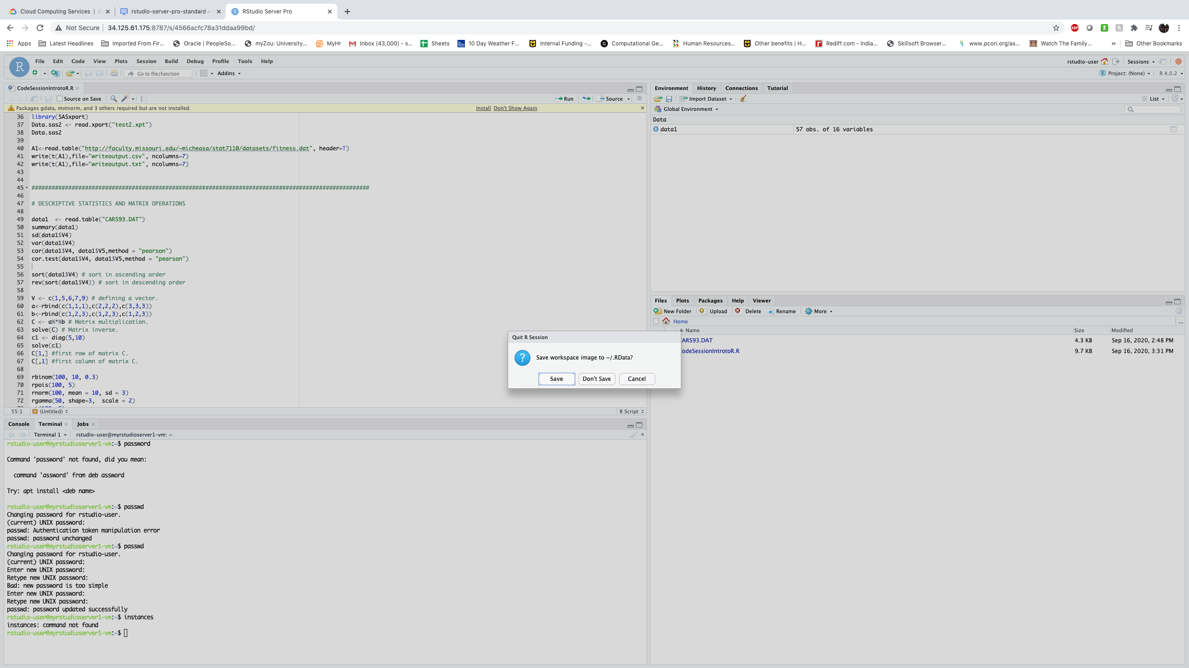
Quitting R studio

Slide 55
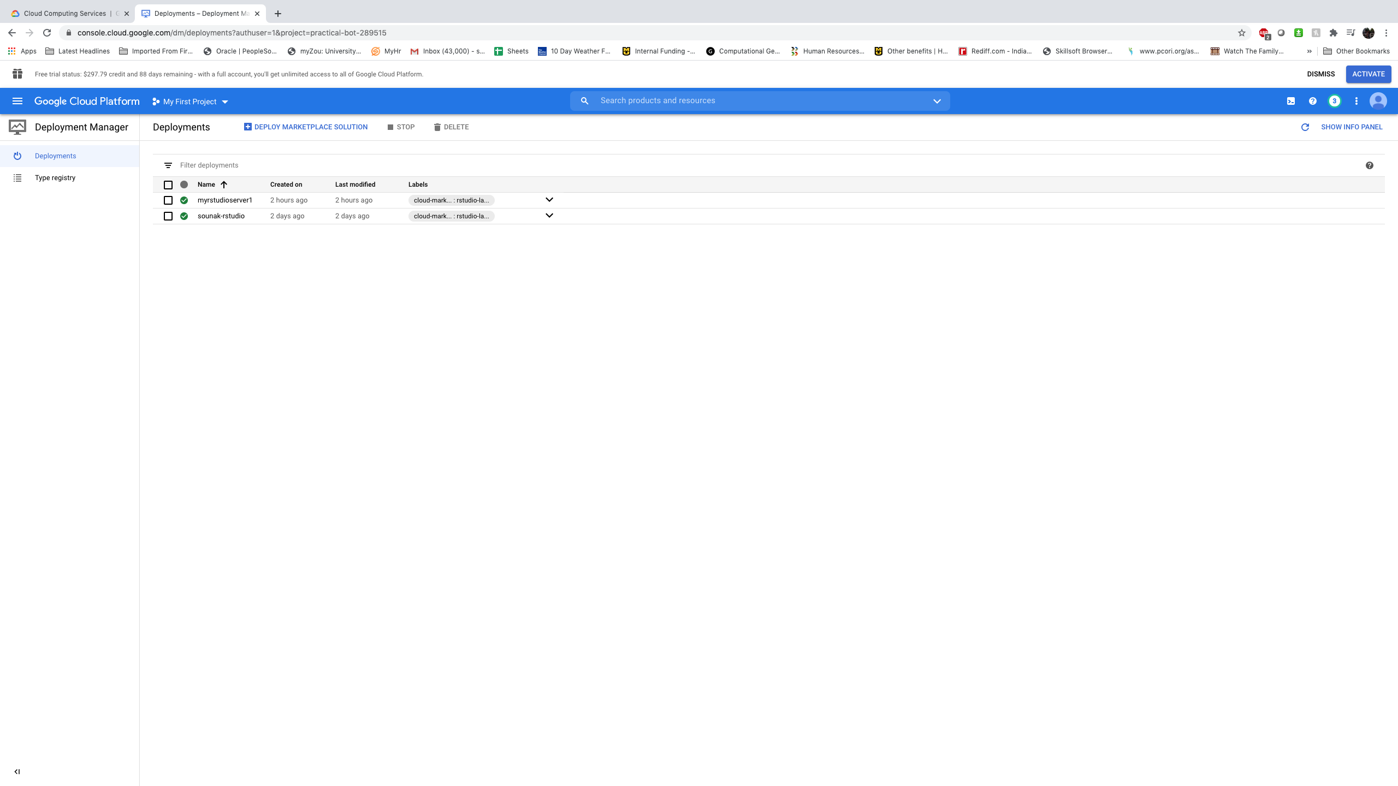
Click on the deployment manager to see all rstudio servers you have created

Slide 56
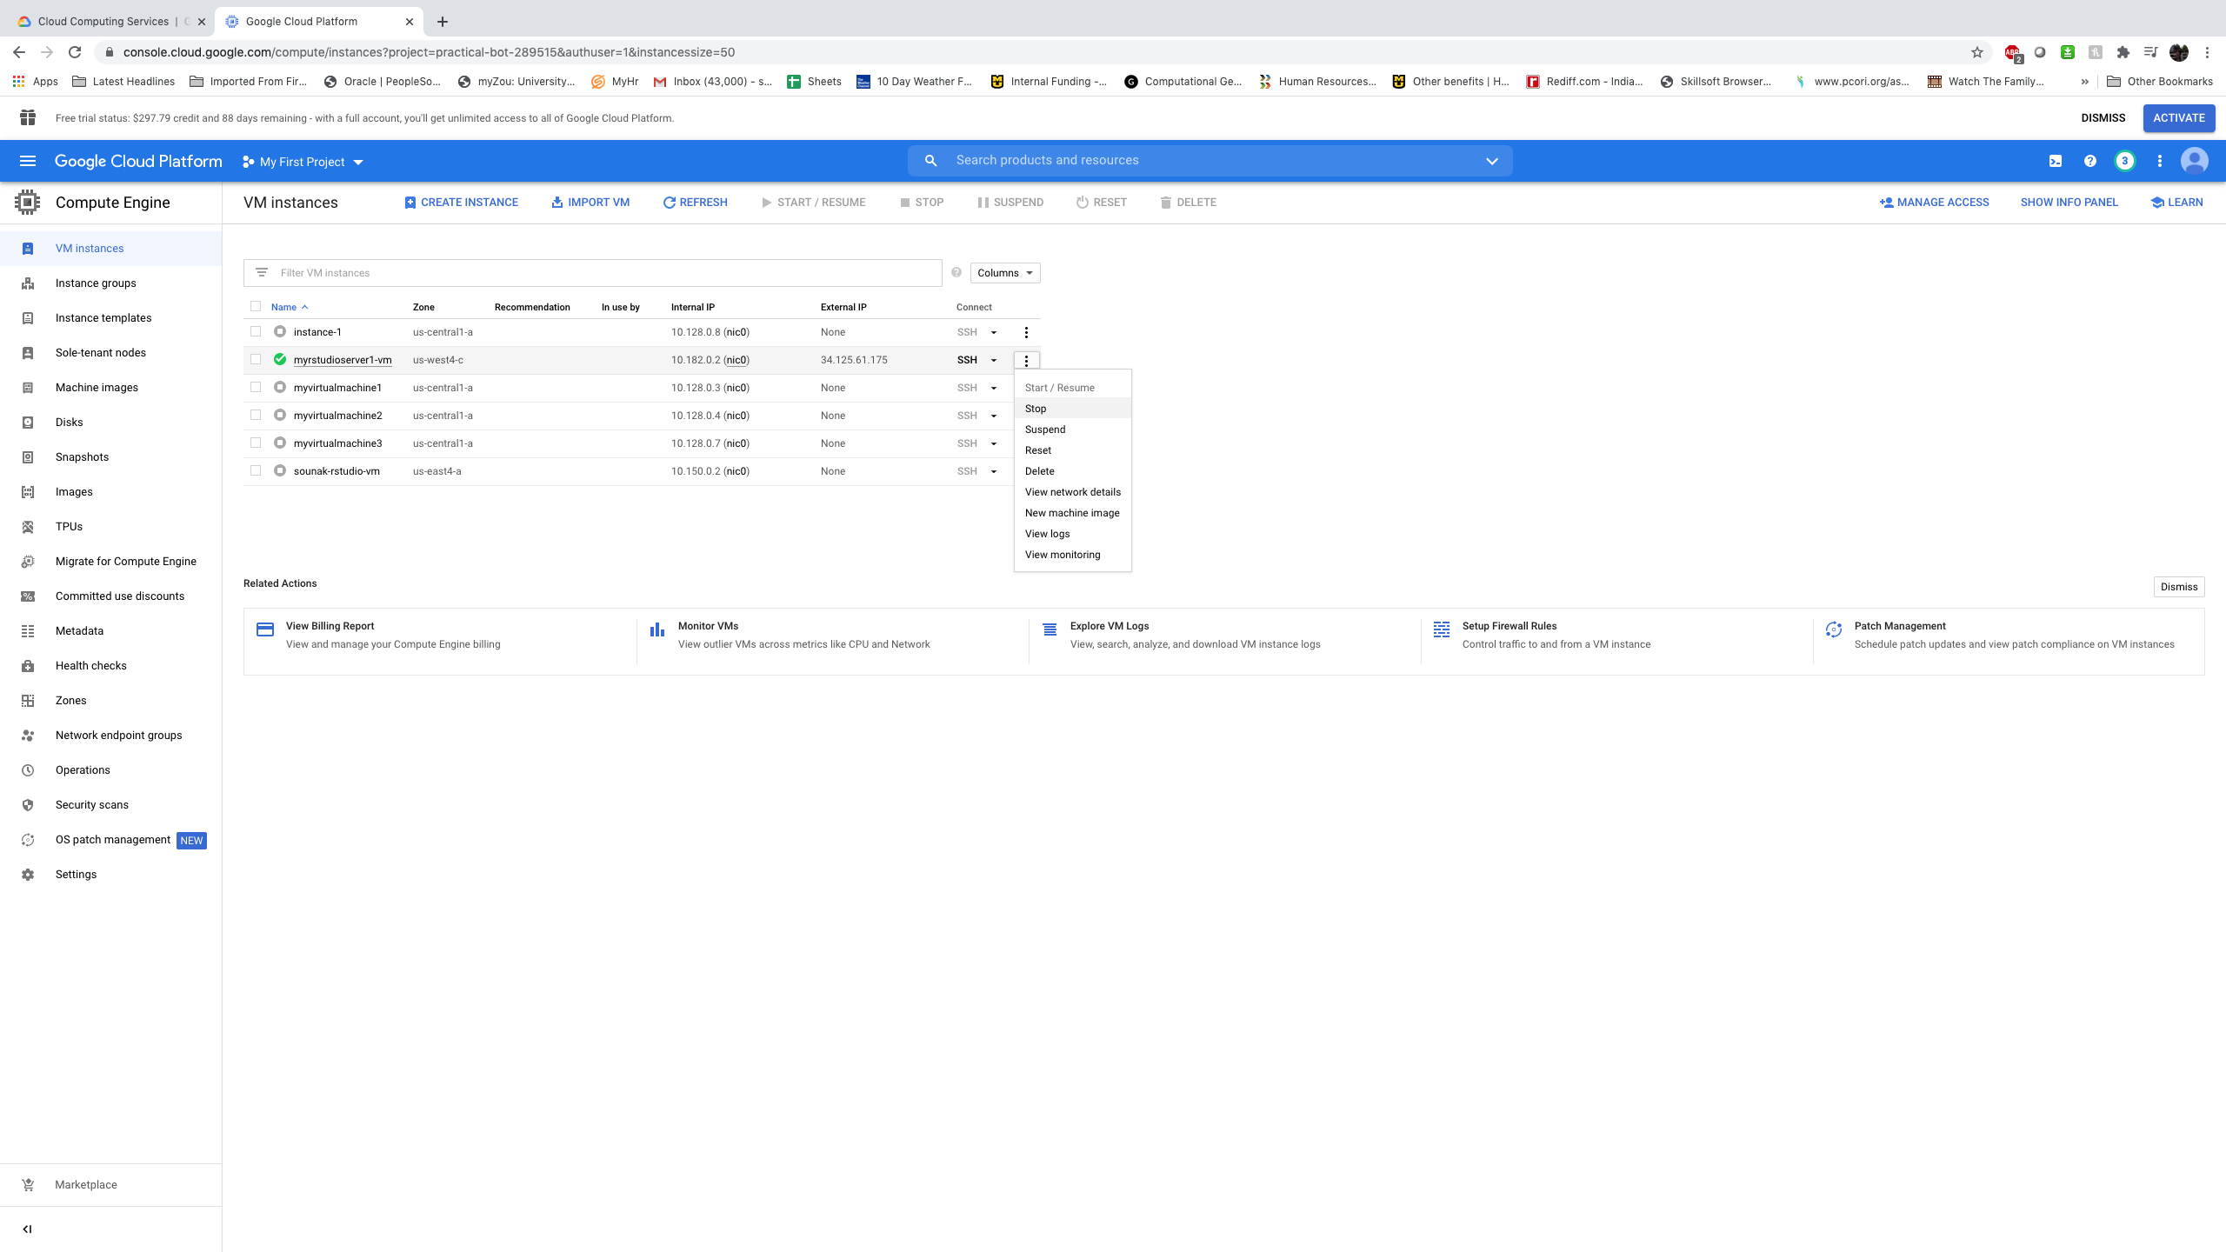
Go back to google compute engine and stop the rstudio vm

Slide 57
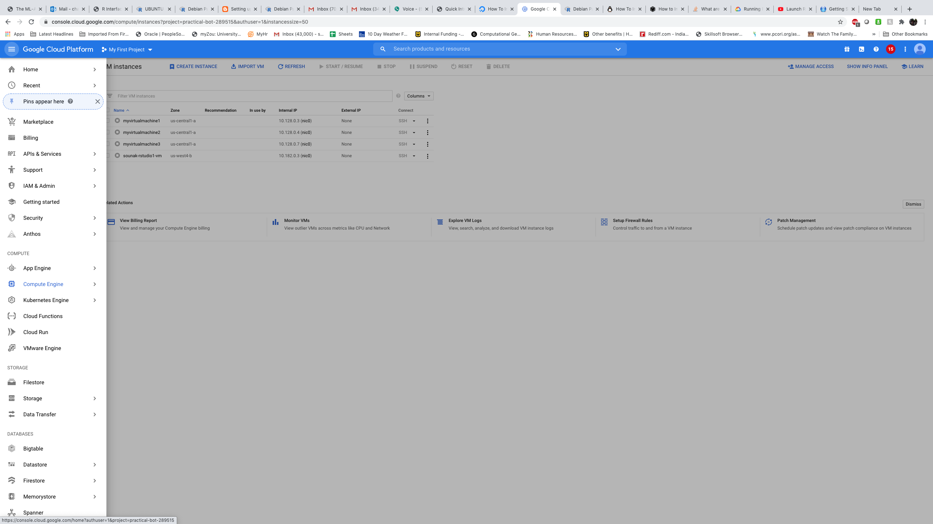
How to reuse the created Rstudio vm
Click on Compute Engine

Slide 58
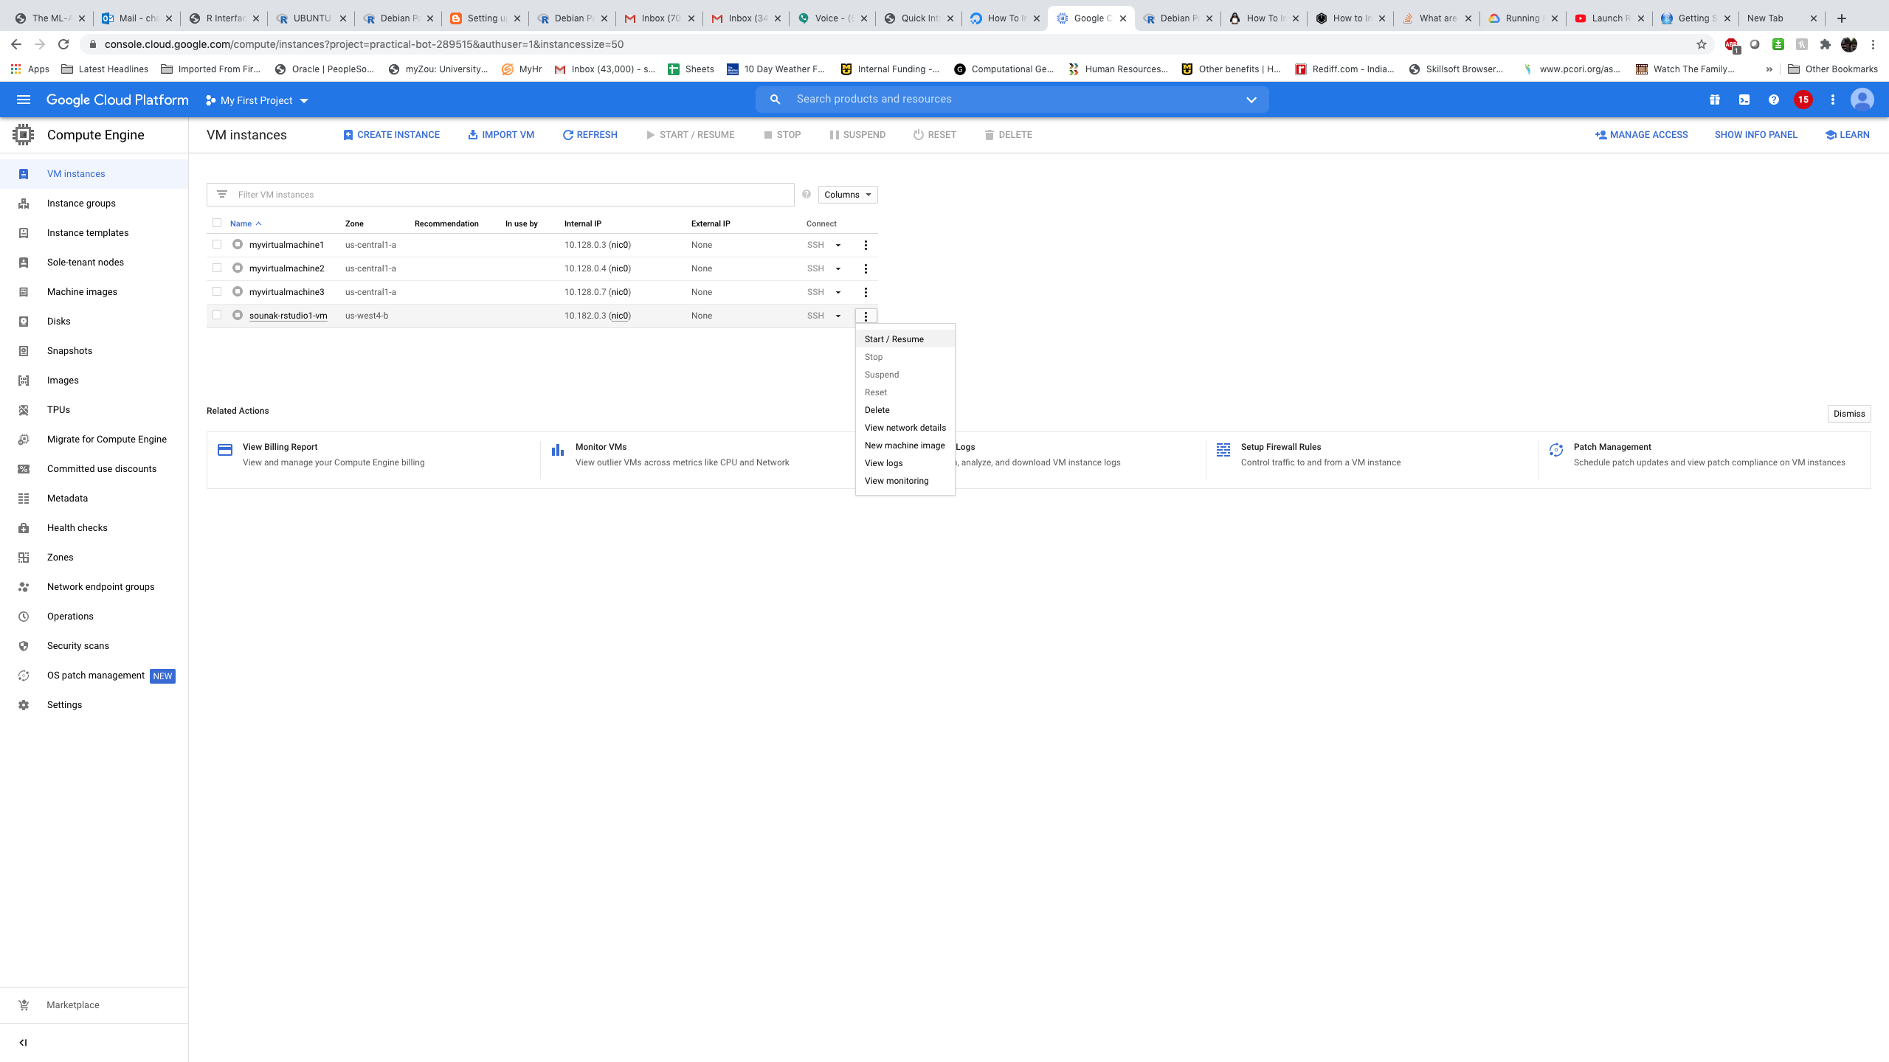
How to reuse the created Rstudio vm
Start the RSTUDIO VM

Slide 59
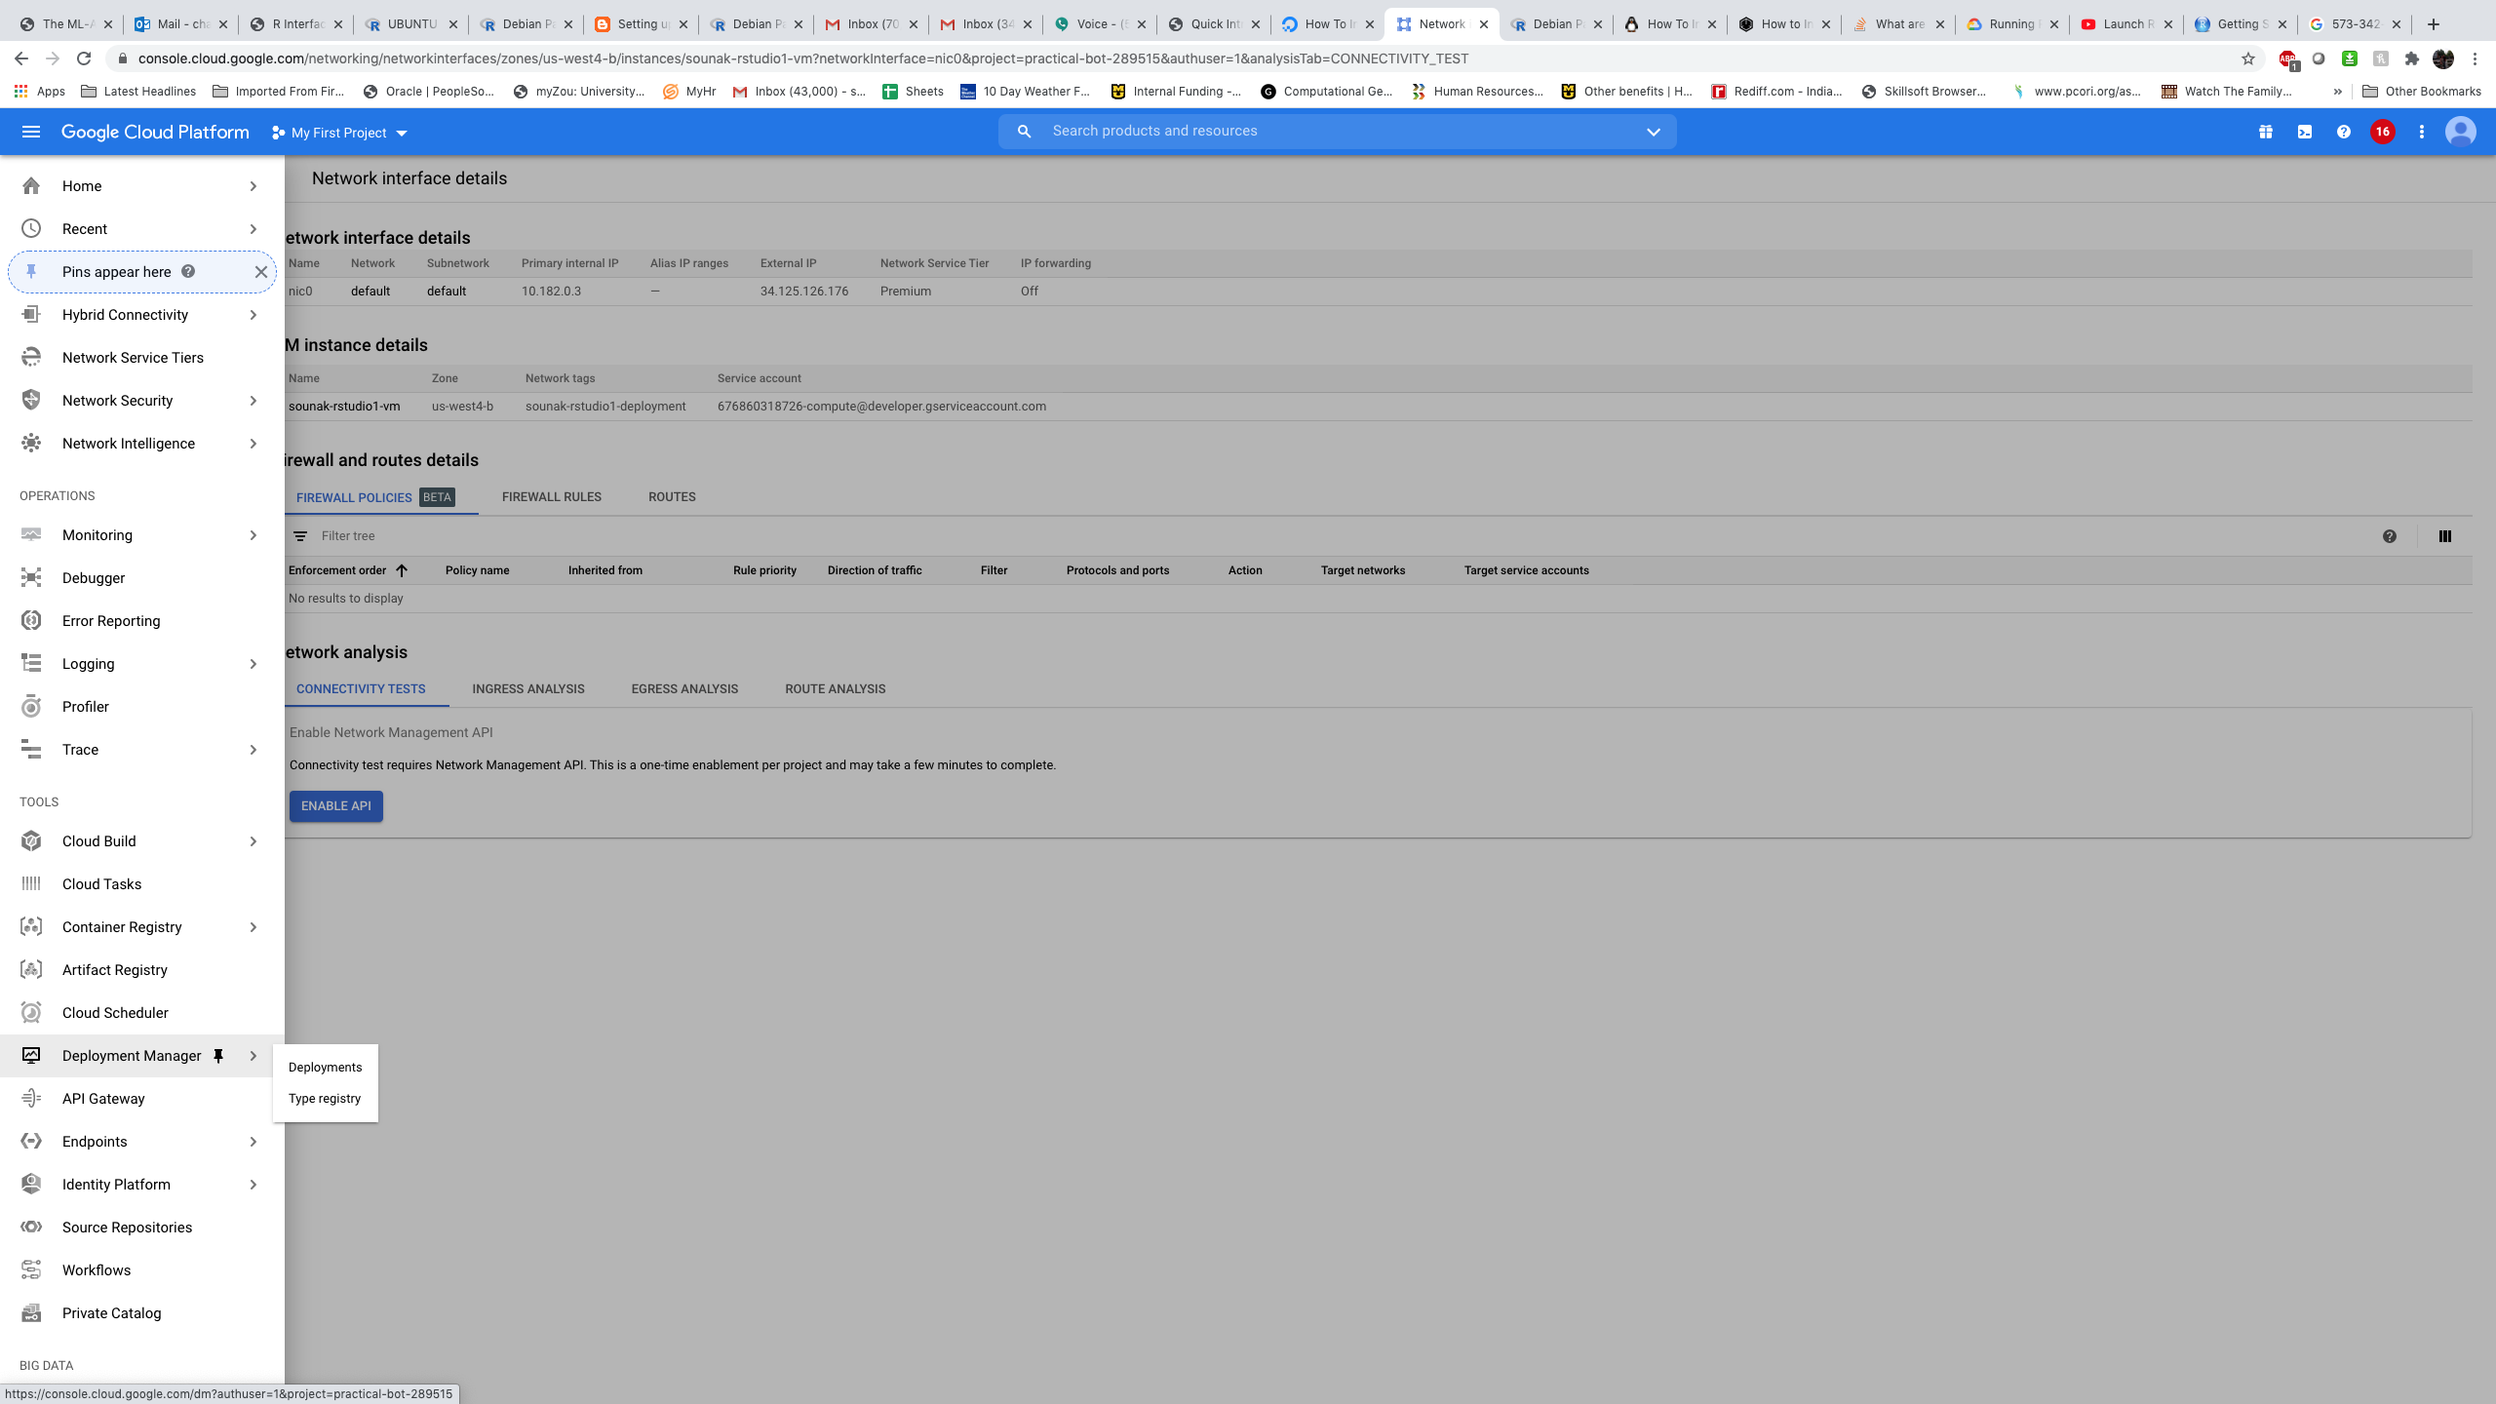
How to reuse the created Rstudio vm
Click on Deployment Manager

Slide 60
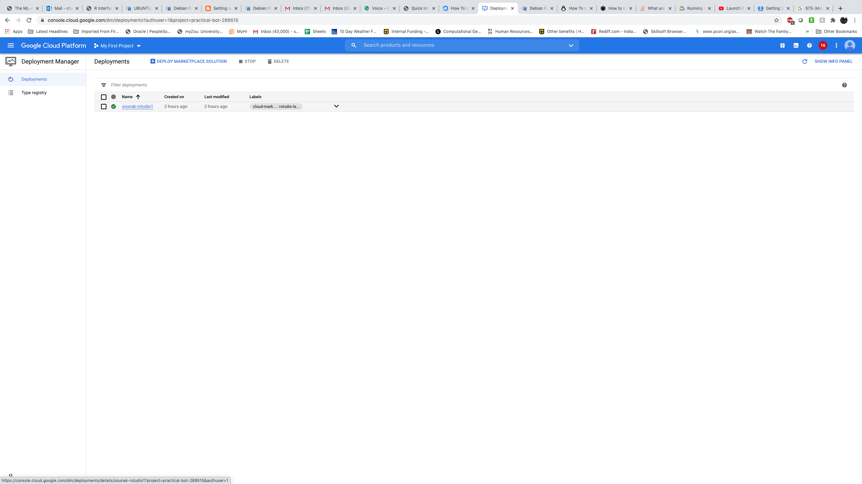
How to reuse the created Rstudio vm
Click on your RSTUDIO machine

Slide 61
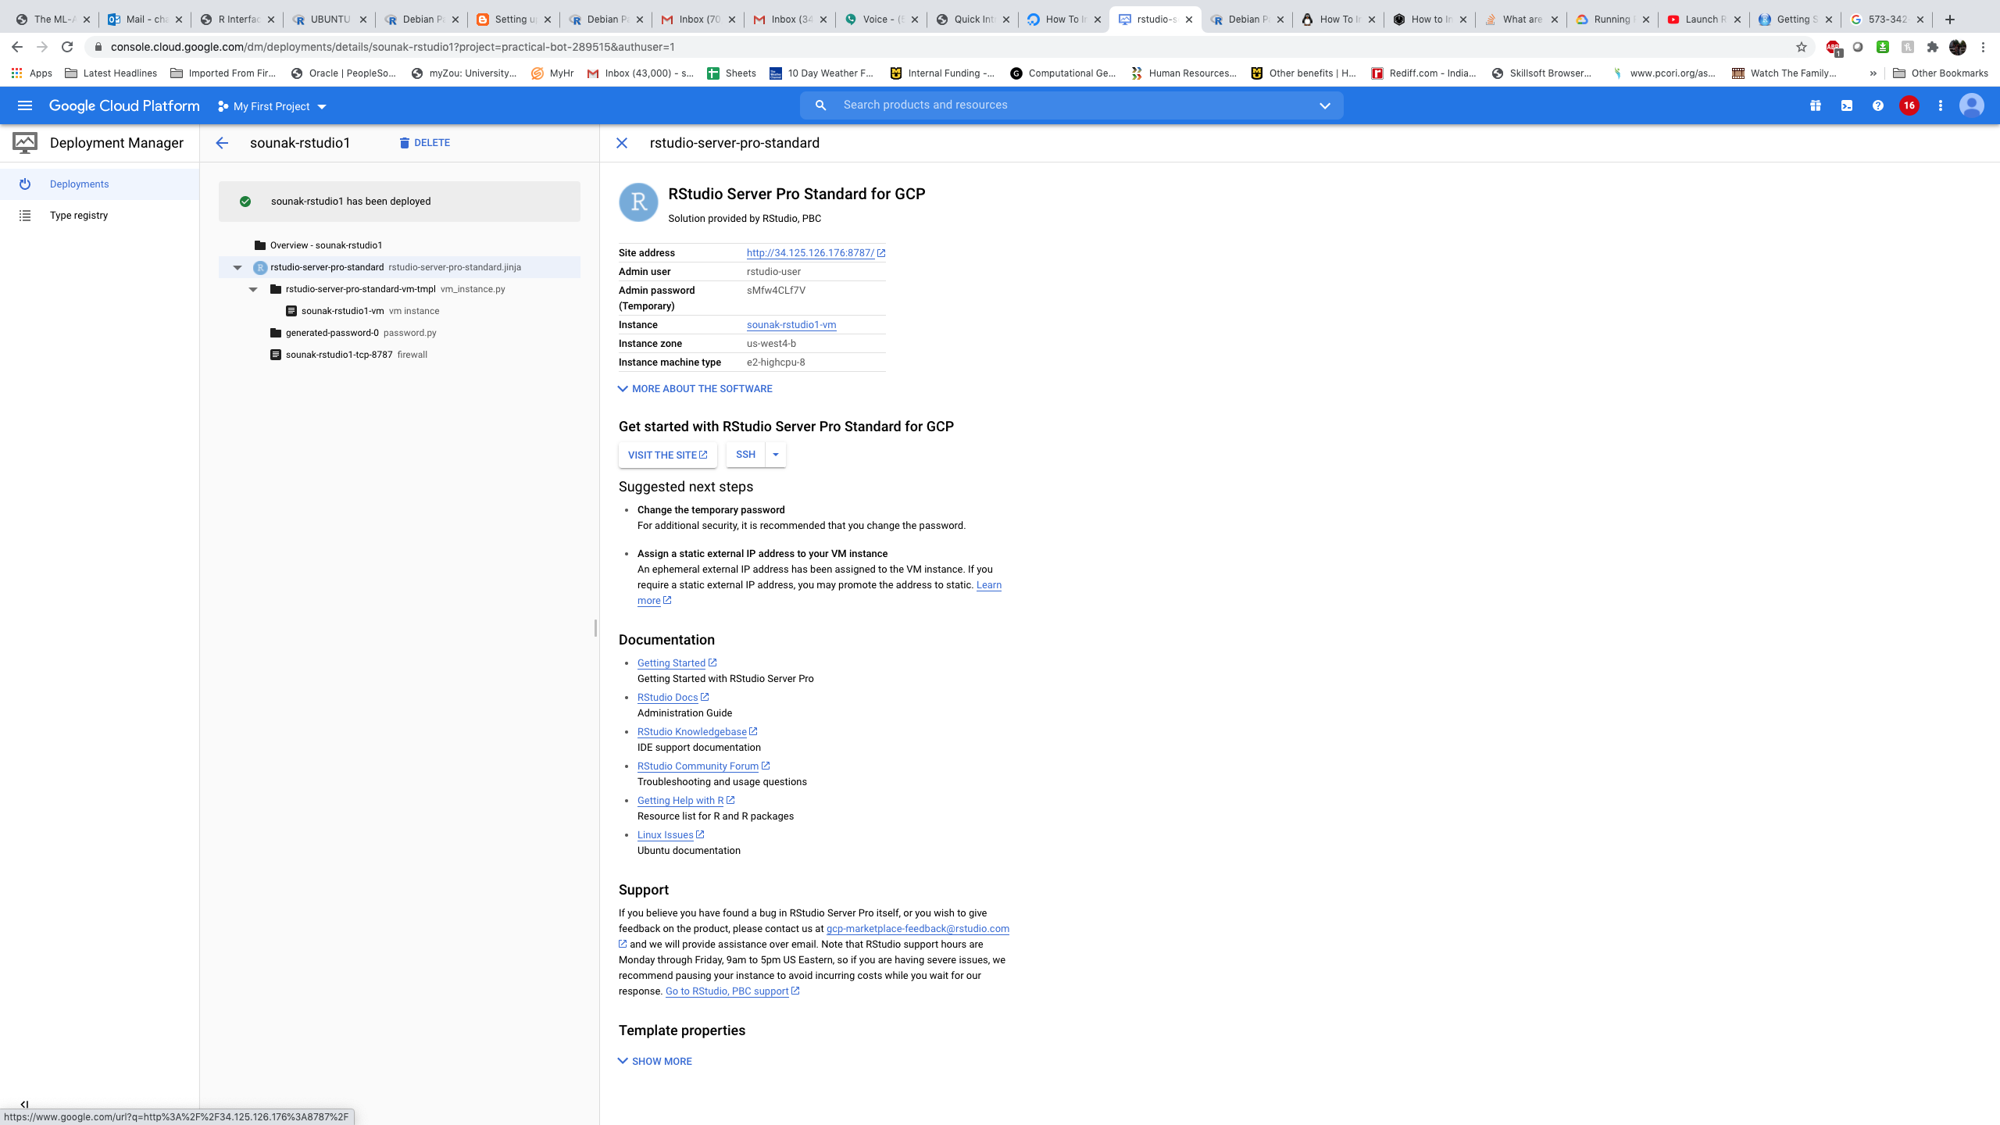
How to reuse the created Rstudio vm
Click on the link and go to login screen. If you changed the password you will use your own new password.

Slide 62
What did we learn ?
How to set up virtual machines in google cloud.
How to install R and run codes in a linux shell command.
How to use R for parallel computing using multiple cores.
How to set up RStudio server in Google Cloud and Run code

Slide 63

THANK YOU SOUNAK CHAKRABORTY CHAKRABORTYS@MISSOURI.EDU http://faculty.missouri.edu/chakrabortys/

